Slide 1
Unit-2 Fourier series & Integral 2130002 – Advanced Engineering Mathematics

Slide 2
Why Fourier series ?
We know that Taylor’s series representation of functions are valid only for those functions which are continuous and differentiable.
As we know that discontinuous periodic functions can not be expanded in Taylor’s series, but such functions can easily be expanded in terms of infinite series containing “sine” and “cosine” terms by Fourier series.
Fourier series applies to all continuous, periodic and also discontinuous in their values.

Slide 3

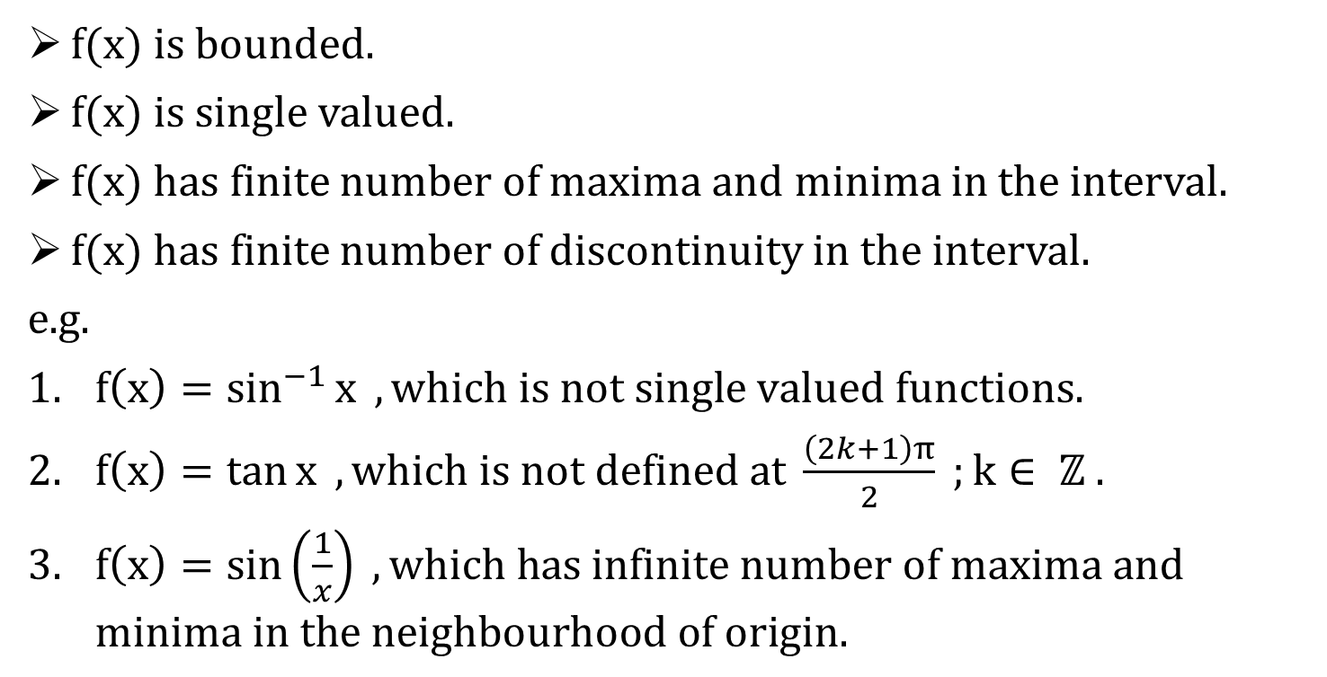
Dirichlet Condition for existence of Fourier series of $f(x)$
$f(x)$ is bounded.
$f(x)$ is single valued.
$f(x)$ has finite number of maxima and minima in the interval.
$f(x)$ has finite number of discontinuity in the interval.
e.g.
$f\left(x\right)=\sin^{−1}{x} , which is not single valued functions.$
$f\left(x\right)=\tan{x} , which is not defined at \frac{\left(2k+1\right)π}{2} ;k∈ ℤ .$
$f\left(x\right)=\sin\left(\frac{1}{x}\right) , which \text{has} \text{in}\text{finite} \text{number} \text{of} \text{maxima} \text{and} \text{minima} \text{in} \text{the} \text{neighbourhood} \text{of} \text{origin}.$

Slide 4

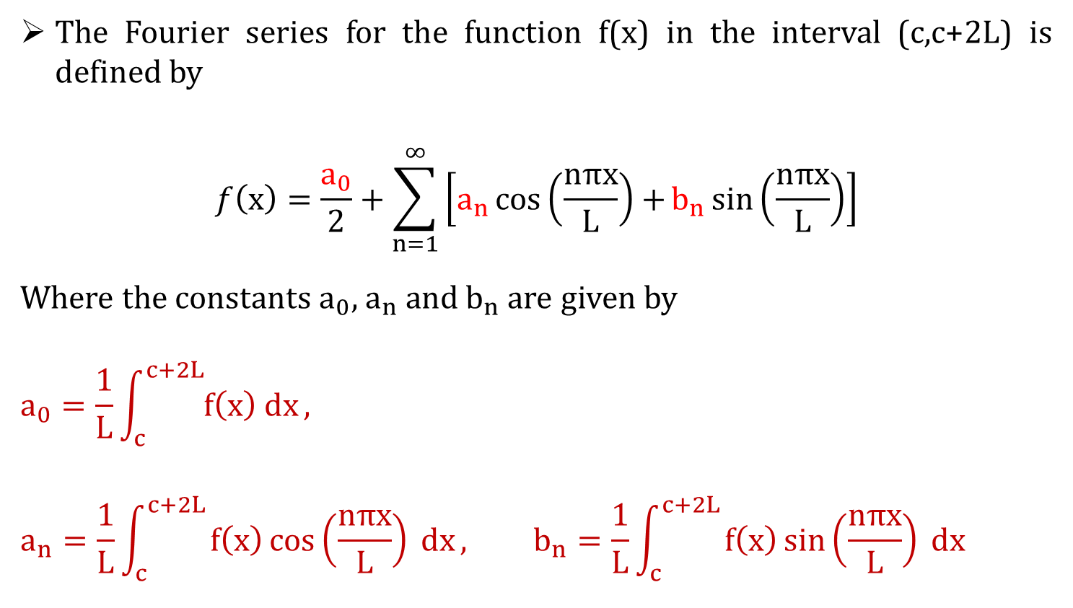
Fourier Series in the interval $(c,c+2L)$
The Fourier series for the function f(x) in the interval (c,c+2L) is defined by
$$f\left(x\right)=\frac{a_{0}}{2}+\sum_{n=1}^{∞}{\left[a_{n}\cos\left(\frac{nπx}{L}\right)+b_{n}\sin\left(\frac{nπx}{L}\right)\right]}$$
Where the constants${ a}_{0}$, $a_{n}$ and $b_{n}$ are given by
$$a_{0}=\frac{1}{L}\int_{c}^{c+2L}{f\left(x\right) dx},$$
$$a_{n}=\frac{1}{L}\int_{c}^{c+2L}{f\left(x\right)\cos\left(\frac{nπx}{L}\right) dx}, b_{n}=\frac{1}{L}\int_{c}^{c+2L}{f\left(x\right)\sin\left(\frac{nπx}{L}\right) dx}$$

Slide 5
Types of intervals
Fourier Series in the interval $(−L,L)$
Fourier Series in the interval (−𝐋,𝐋)
Fourier Series in the interval $(0,2L)$
Fourier Series in the interval (𝟎,𝟐𝐋)

Slide 6

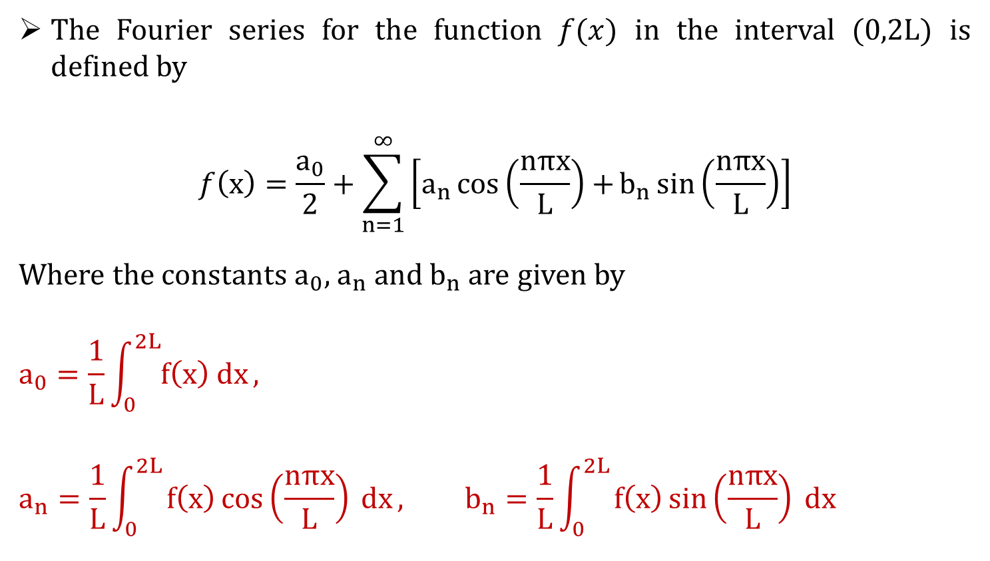
Fourier Series in the interval $(0,2L)$
The Fourier series for the function $f(x)$ in the interval $(0,2L)$ is defined by
$$f\left(x\right)=\frac{a_{0}}{2}+\sum_{n=1}^{∞}{\left[a_{n}\cos\left(\frac{nπx}{L}\right)+b_{n}\sin\left(\frac{nπx}{L}\right)\right]}$$
Where the constants${ a}_{0}$, $a_{n}$ and $b_{n}$ are given by
$$a_{0}=\frac{1}{L}\int_{0}^{2L}{f\left(x\right) dx},$$
$$a_{n}=\frac{1}{L}\int_{0}^{2L}{f\left(x\right)\cos\left(\frac{nπx}{L}\right) dx}, b_{n}=\frac{1}{L}\int_{0}^{2L}{f\left(x\right)\sin\left(\frac{nπx}{L}\right) dx}$$

Slide 7

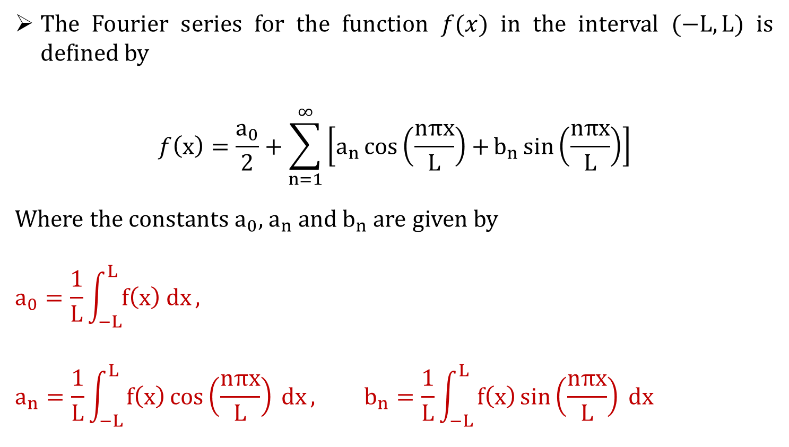
Fourier Series in the interval $(−L,L)$
The Fourier series for the function $f(x)$ in the interval $(−L,L)$ is defined by
$$f\left(x\right)=\frac{a_{0}}{2}+\sum_{n=1}^{∞}{\left[a_{n}\cos\left(\frac{nπx}{L}\right)+b_{n}\sin\left(\frac{nπx}{L}\right)\right]}$$
Where the constants${ a}_{0}$, $a_{n}$ and $b_{n}$ are given by
$$a_{0}=\frac{1}{L}\int_{−L}^{L}{f\left(x\right) dx},$$
$$a_{n}=\frac{1}{L}\int_{−L}^{L}{f\left(x\right)\cos\left(\frac{nπx}{L}\right) dx}, b_{n}=\frac{1}{L}\int_{−L}^{L}{f\left(x\right)\sin\left(\frac{nπx}{L}\right) dx}$$

Slide 8
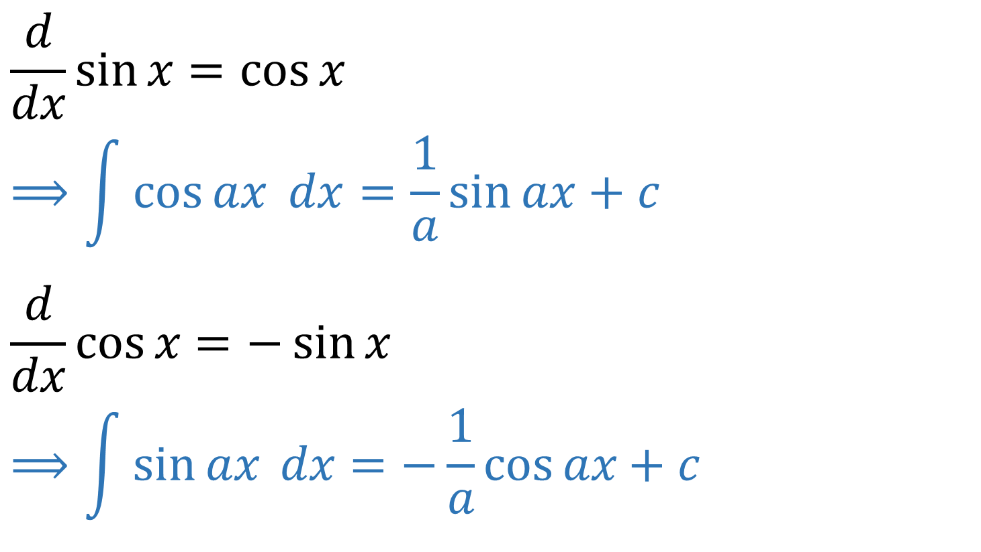
Basic formulae
$$\frac{d}{dx}\sin{x}=\cos{x}$$
$$⟹\int{\cos{ax} dx}=\frac{1}{a}\sin{ax}+c$$
$$\frac{d}{dx}\cos{x}=−\sin{x}$$
$$⟹\int{\sin{ax} dx}=−\frac{1}{a}\cos{ax}+c$$

Slide 9
Types of Functions
Exponential function
Trigonometric function
Polynomial function

Slide 10
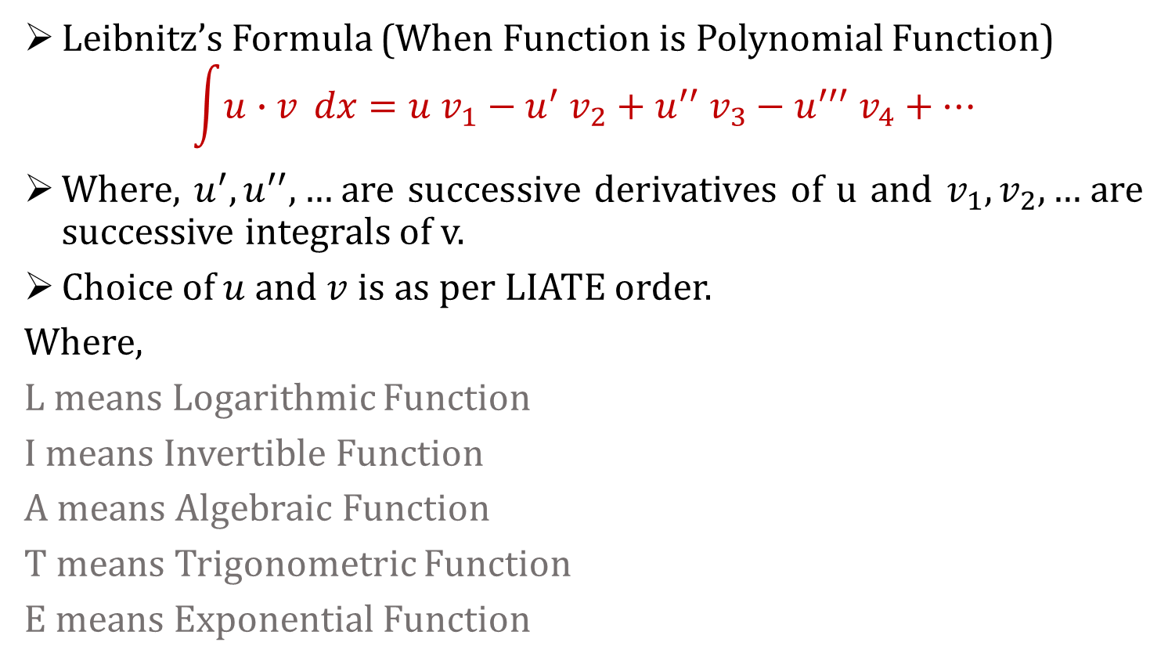
Polynomial function
Leibnitz’s Formula (When Function is Polynomial Function)
$$\int{u∙v} dx=u v_{1}−u^{′} v_{2}+u^{′′} v_{3}−u^{′′′} v_{4}+⋯$$
Where, $u^{′},u^{′′},…$are successive derivatives of u and $v_{1},v_{2},…$are successive integrals of v.
Choice of $u$ and $v$ is as per LIATE order.
Where,
L means Logarithmic Function
I means Invertible Function
A means Algebraic Function
T means Trigonometric Function
E means Exponential Function

Slide 11
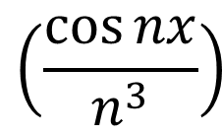
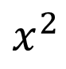
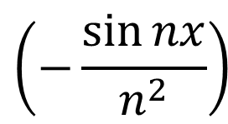
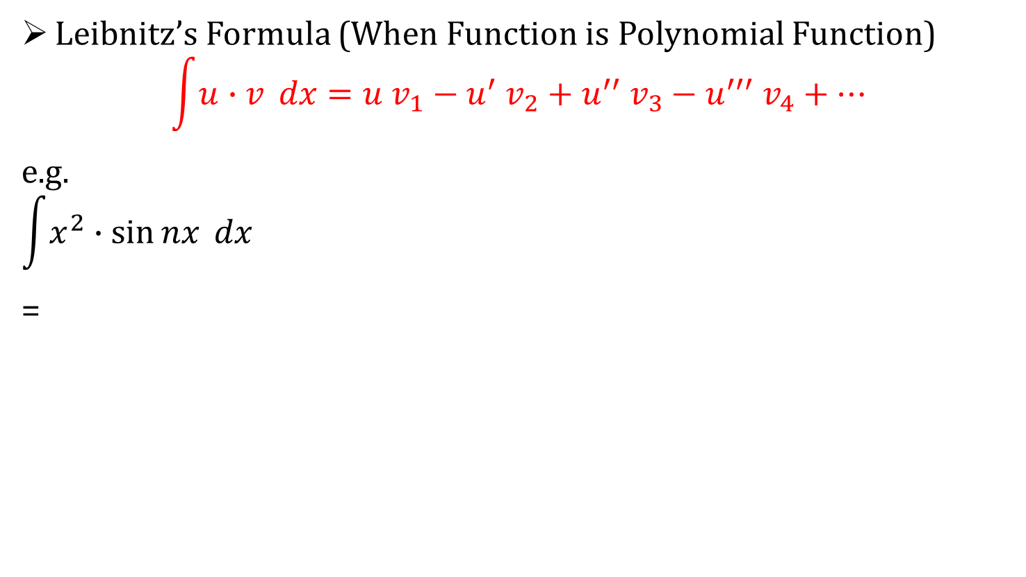
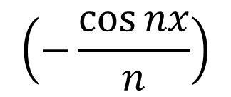



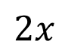
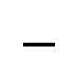
Polynomial function
Leibnitz’s Formula (When Function is Polynomial Function)
$$\int{u∙v} dx=u v_{1}−u^{′} v_{2}+u^{′′} v_{3}−u^{′′′} v_{4}+⋯$$
e.g.
$$\int{x^{2}∙\sin{nx}} dx$$
=
$$\left(−\frac{\cos{nx}}{n}\right)$$
$$+$$
$$x^{2}$$
$$\left(−\frac{\sin{nx}}{n^{2}}\right)$$
$$−$$
$$2x$$
$$+$$
$$2$$
$$\left(\frac{\cos{nx}}{n^{3}}\right)$$

Slide 12
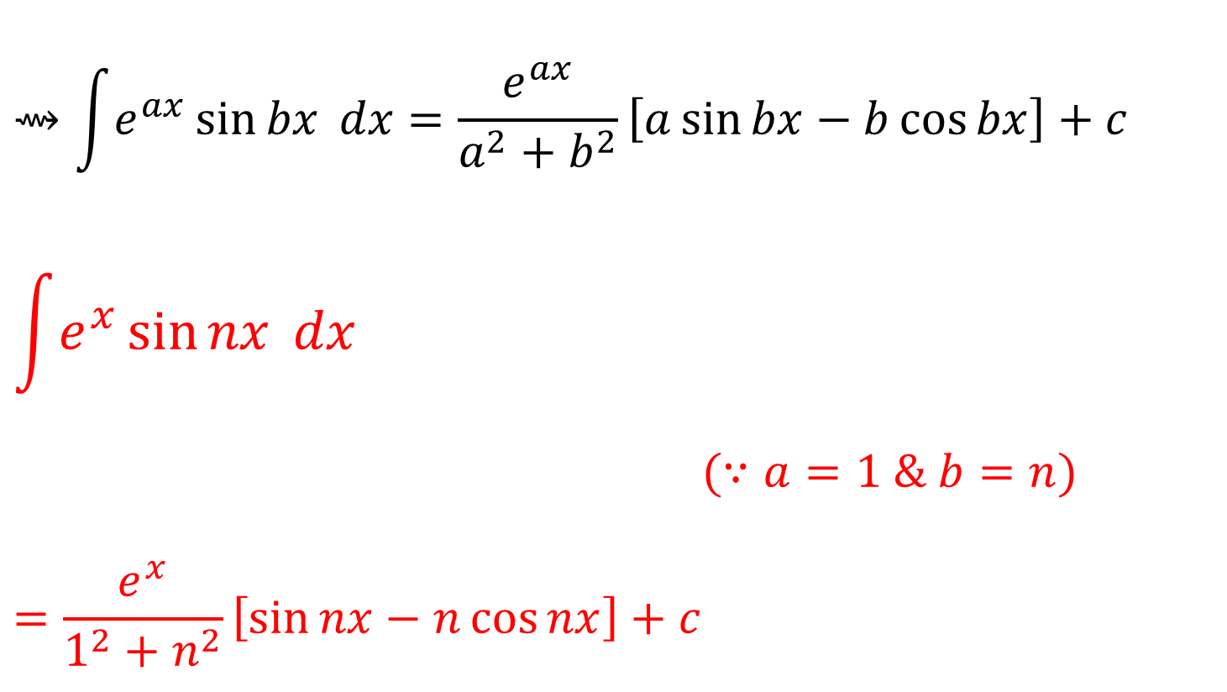
Exponential function
$$⇝\int{e^{ax}}\sin{bx} dx=\frac{e^{ax}}{a^{2}+b^{2}}\left[a\sin{bx}−b\cos{bx}\right]+c$$
$$\int{e^{x}}\sin{nx} dx$$
$(∵a=1 \& b=n)$
$$=\frac{e^{x}}{1^{2}+n^{2}}\left[\sin{nx}−n\cos{nx}\right]+c$$

Slide 13
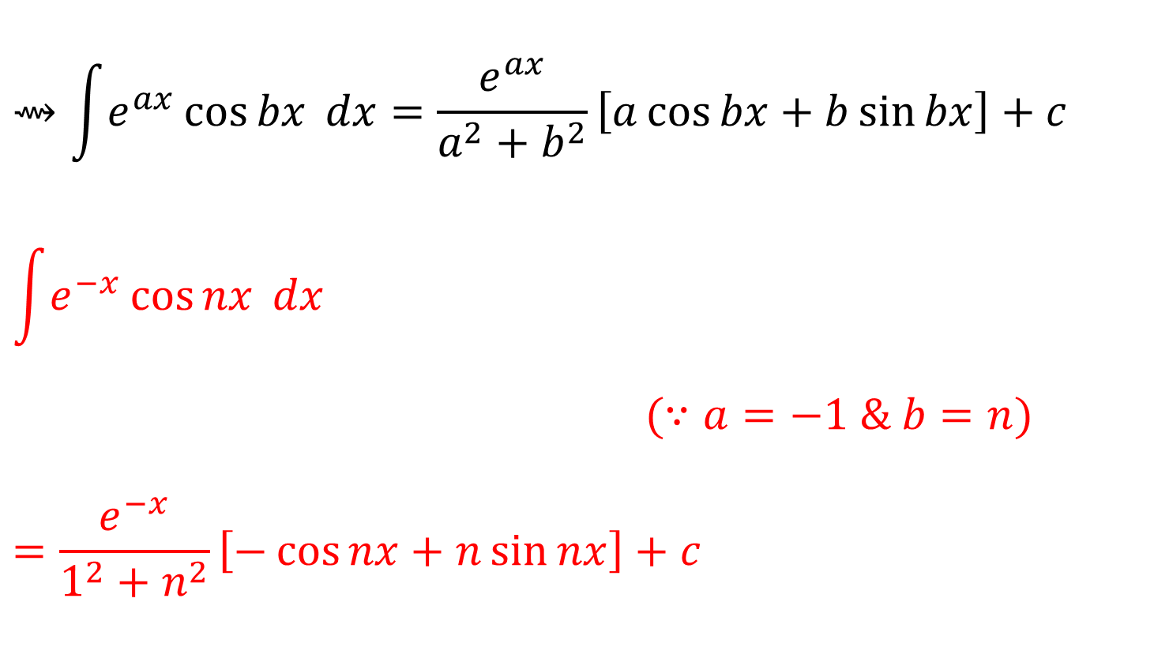
Exponential function
$$⇝\int{e^{ax}}\cos{bx} dx=\frac{e^{ax}}{a^{2}+b^{2}}\left[a\cos{bx}+b\sin{bx}\right]+c$$
$$\int{e^{−x}}\cos{nx} dx$$
$(∵a=−1 \& b=n)$
$$=\frac{e^{−x}}{1^{2}+n^{2}}\left[−\cos{nx}+n\sin{nx}\right]+c$$

Slide 14
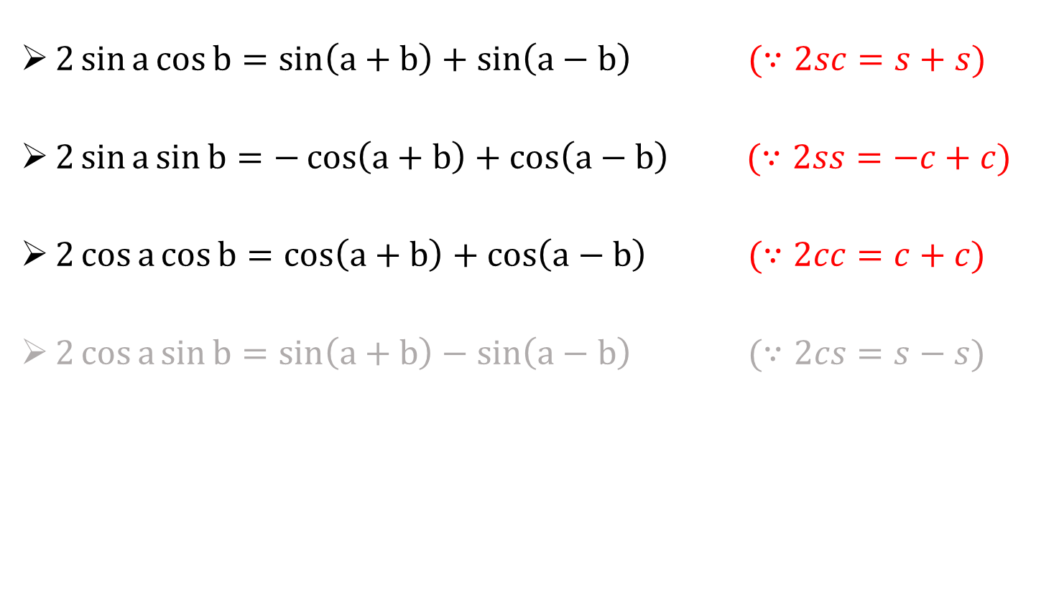
Trigonometric function
$2\sin{a}\cos{b}=\sin\left(a+b\right)+\sin\left(a−b\right) (∵2sc=s+s)$
$2\sin{a}\sin{b}=−\cos\left(a+b\right)+\cos\left(a−b\right) (∵2ss=−c+c)$
$2\cos{a}\cos{b}=\cos\left(a+b\right)+\cos\left(a−b\right) (∵2cc=c+c)$
$2\cos{a}\sin{b}=\sin\left(a+b\right)−\sin\left(a−b\right) (∵2cs=s−s)$

Slide 15
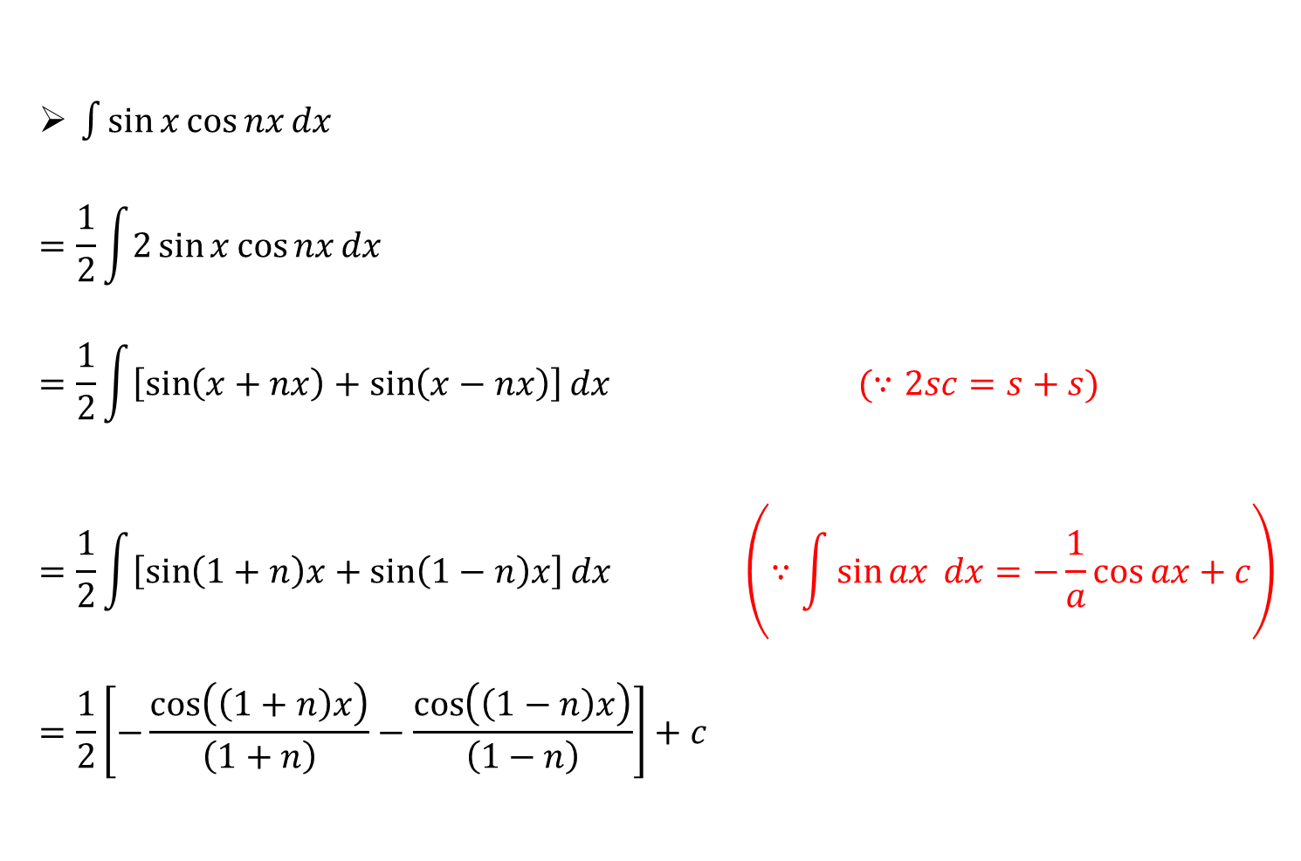
Trigonometric function
$\int{\sin{x}\cos{nx}}dx$
$$=\frac{1}{2}\int{2\sin{x}\cos{nx}}dx$$
$$=\frac{1}{2}\int{\left[\sin\left(x+nx\right)+\sin\left(x−nx\right)\right]}dx (∵2sc=s+s)$$
$$=\frac{1}{2}\int{\left[\sin\left(1+n\right)x+\sin\left(1−n\right)x\right]}dx \left(∵\int{\sin{ax} dx}=−\frac{1}{a}\cos{ax}+c\right)$$
$$=\frac{1}{2}\left[−\frac{\cos\left(\left(1+n\right)x\right)}{\left(1+n\right)}−\frac{\cos\left(\left(1−n\right)x\right)}{\left(1−n\right)}\right]+c$$

Slide 16
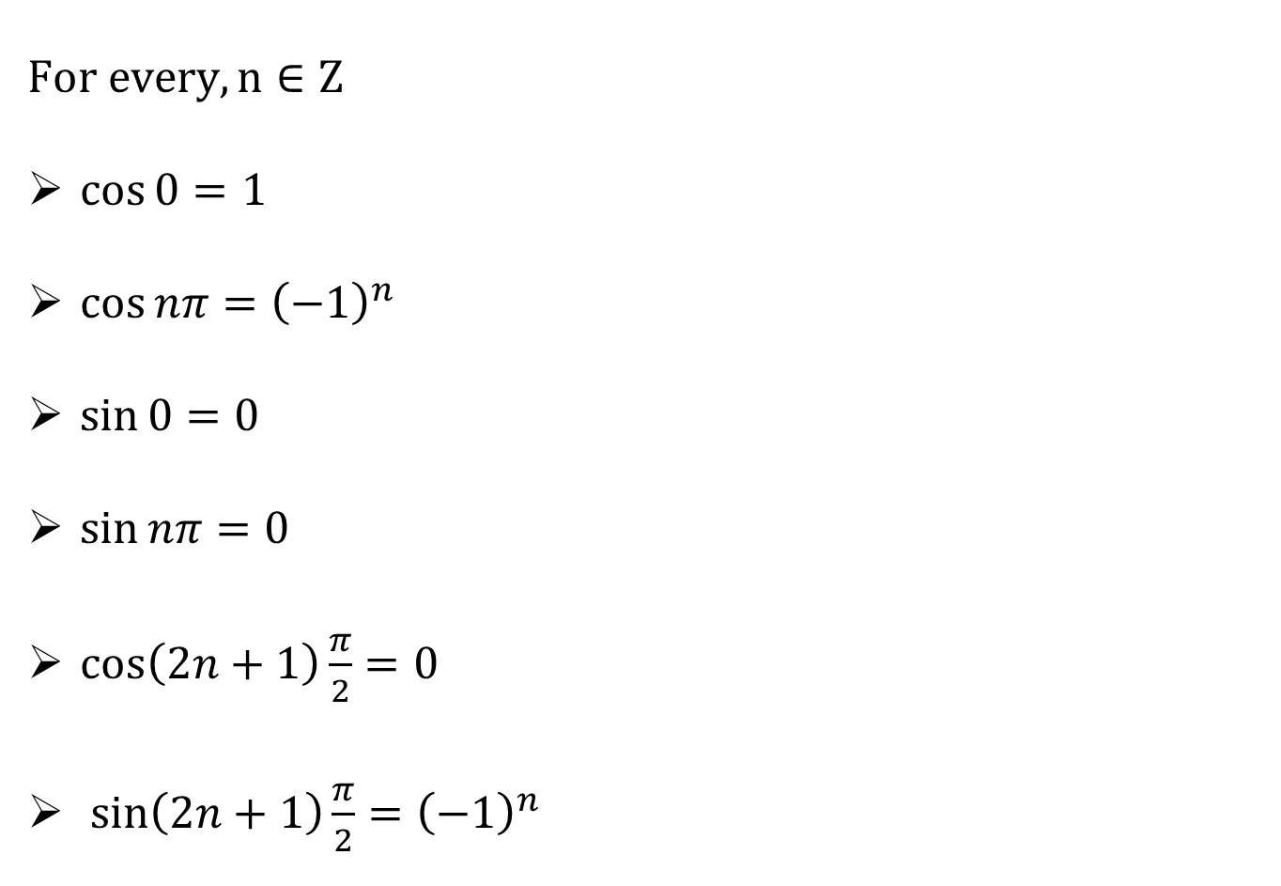
Trigonometric Values
$$For every, n∈Z$$
$\cos{0}=1$
$\cos{nπ}={\left(−1\right)}^{n}$
$\sin{0}=0$
$\sin{nπ}=0$
$\cos\left(2n+1\right)\frac{π}{2}=0$
$\sin\left(2n+1\right)\frac{π}{2}={\left(−1\right)}^{n}$

Slide 17
Fourier Series in the interval $(0,2L)$
The Fourier series for the function $f(x)$ in the interval $(0,2L)$ is defined by
$$f\left(x\right)=\frac{a_{0}}{2}+\sum_{n=1}^{∞}{\left[a_{n}\cos\left(\frac{nπx}{L}\right)+b_{n}\sin\left(\frac{nπx}{L}\right)\right]}$$
Where the constants${ a}_{0}$, $a_{n}$ and $b_{n}$ are given by
$$a_{0}=\frac{1}{L}\int_{0}^{2L}{f\left(x\right) dx},$$
$$a_{n}=\frac{1}{L}\int_{0}^{2L}{f\left(x\right)\cos\left(\frac{nπx}{L}\right) dx}, b_{n}=\frac{1}{L}\int_{0}^{2L}{f\left(x\right)\sin\left(\frac{nπx}{L}\right) dx}$$

Slide 18
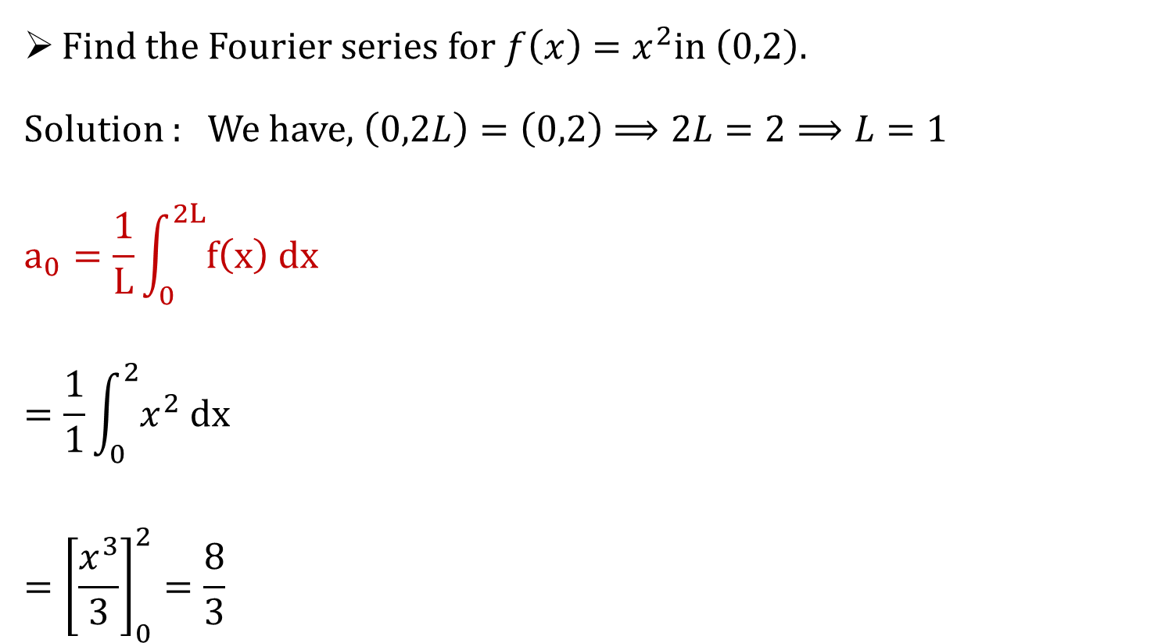
Example 1
Find the Fourier series for $f\left(x\right)=x^{2}$in$\left(0,2\right).$
Solution : We have, $\left(0,2L\right)=\left(0,2\right)⟹2L=2⟹L=1$
$$a_{0}=\frac{1}{L}\int_{0}^{2L}{f\left(x\right) dx}$$
$$=\frac{1}{1}\int_{0}^{2}{x^{2} dx}$$
$$={\left[\frac{x^{3}}{3}\right]}_{0}^{2}=\frac{8}{3}$$

Slide 19
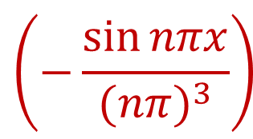

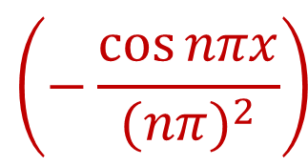
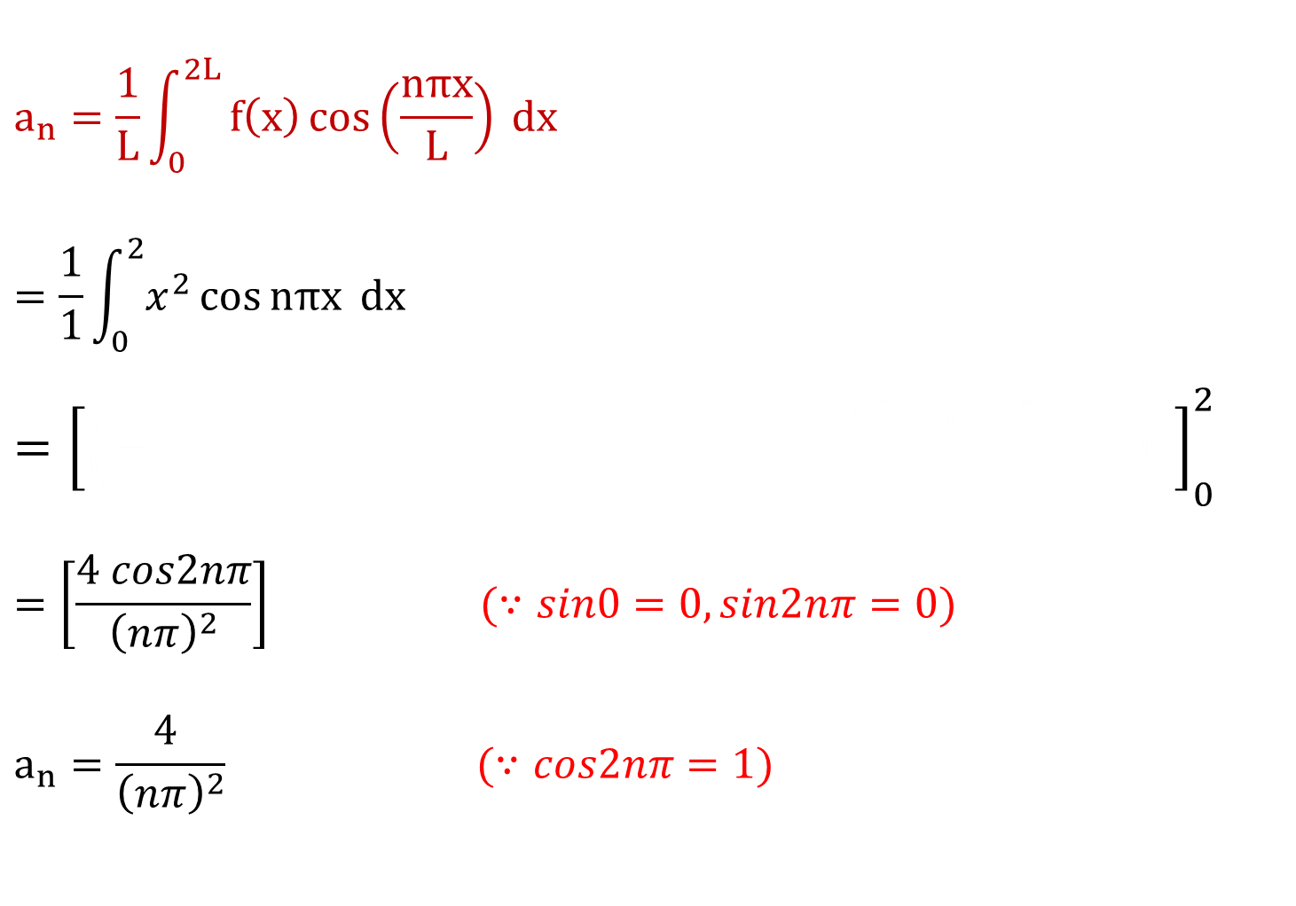
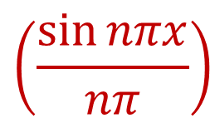


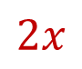

$$a_{n}=\frac{1}{L}\int_{0}^{2L}{f\left(x\right)\cos\left(\frac{nπx}{L}\right) dx}$$
$$=\frac{1}{1}\int_{0}^{2}{x^{2}\cos{nπx} dx}$$
$$={\left[\left(− \frac{\cos{n x }}{n} \right) \right]}_{0}^{2}$$
$$=\left[\frac{4 cos2nπ}{{\left(nπ\right)}^{2}}\right] (∵sin0=0,sin2nπ=0)$$
$$a_{n}=\frac{4 }{{\left(nπ\right)}^{2}} (∵cos2nπ=1)$$
$$\left(\frac{\sin{nπx}}{nπ}\right)$$
$$\left(−\frac{\cos{nπx}}{{(nπ)}^{2}}\right)$$
$$\left(−\frac{\sin{nπx}}{{(nπ)}^{3}}\right)$$
$$x^{2}$$
$$2x$$
$$+$$
$$−$$
$$2$$

Slide 20
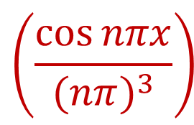
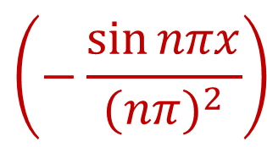
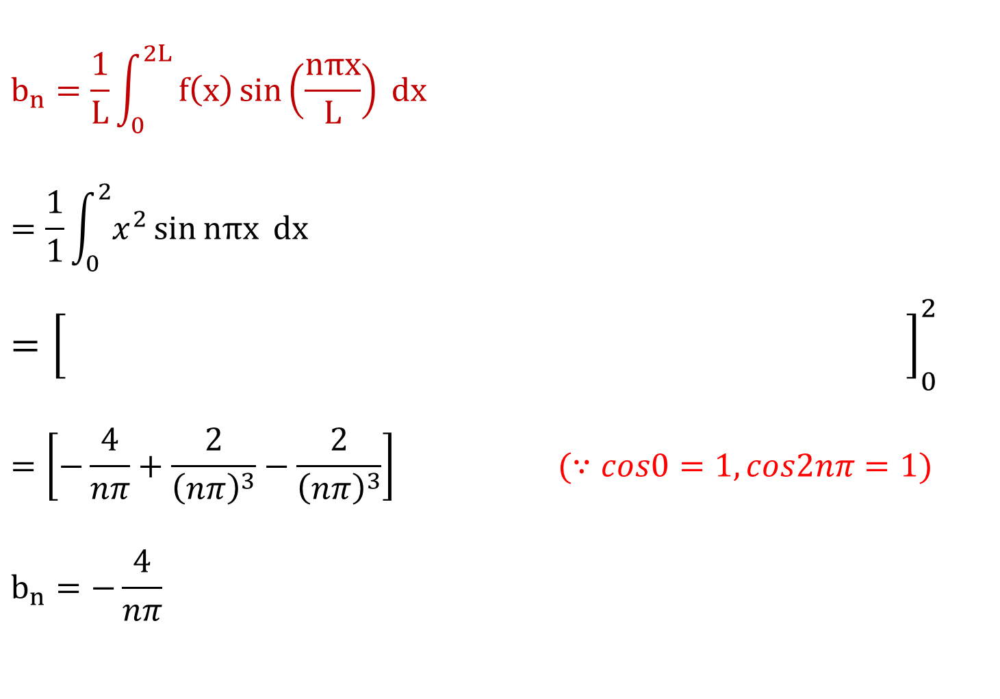
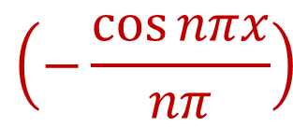


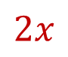

$$b_{n}=\frac{1}{L}\int_{0}^{2L}{f\left(x\right)\sin\left(\frac{nπx}{L}\right) dx}$$
$$=\frac{1}{1}\int_{0}^{2}{x^{2}\sin{nπx} dx}$$
$$={\left[\left(− \frac{\cos{n x }}{n} \right) \right]}_{0}^{2}$$
$$=\left[−\frac{4}{nπ}+\frac{2}{{\left(nπ\right)}^{3}}−\frac{2}{{\left(nπ\right)}^{3}}\right] (∵cos0=1,cos2nπ=1)$$
$$b_{n}=−\frac{4}{nπ}$$
$$\left(−\frac{\cos{nπx}}{nπ}\right)$$
$$\left(−\frac{\sin{nπx}}{{(nπ)}^{2}}\right)$$
$$\left(\frac{\cos{nπx}}{{(nπ)}^{3}}\right)$$
$$x^{2}$$
$$−$$
$$2x$$
$$+$$
$$2$$

Slide 21
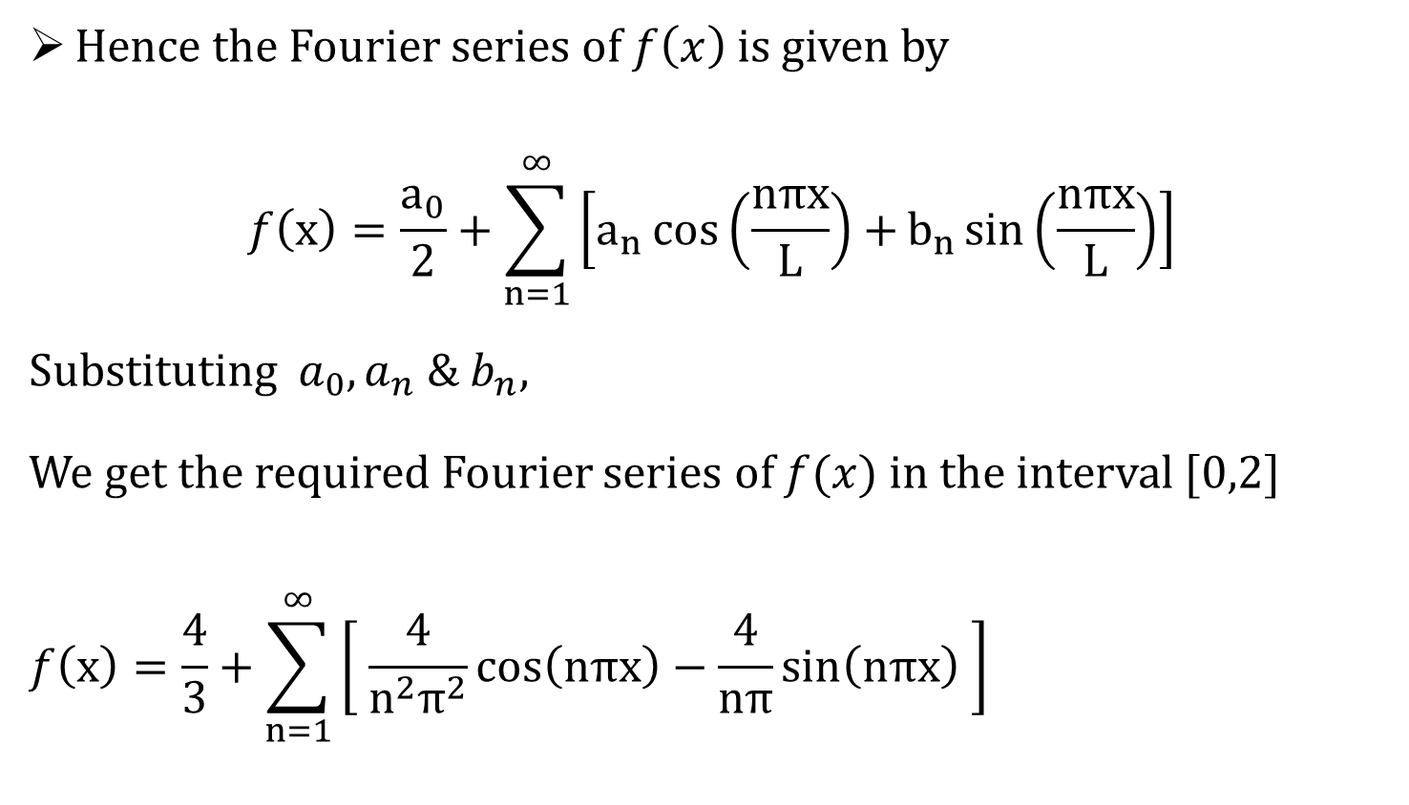
Hence the Fourier series of $f\left(x\right)$ is given by
$$f\left(x\right)=\frac{a_{0}}{2}+\sum_{n=1}^{∞}{\left[a_{n}\cos\left(\frac{nπx}{L}\right)+b_{n}\sin\left(\frac{nπx}{L}\right)\right]}$$
Substituting $a_{0},a_{n} \& b_{n}$,
We get the required Fourier series of $f(x)$ in the interval $[0,2]$
$$f\left(x\right)=\frac{4}{3}+\sum_{n=1}^{∞}{\left[ \frac{4}{n^{2}π^{2}}\cos\left(nπx\right)−\frac{4}{nπ}\sin\left(nπx\right) \right]}$$

Slide 22
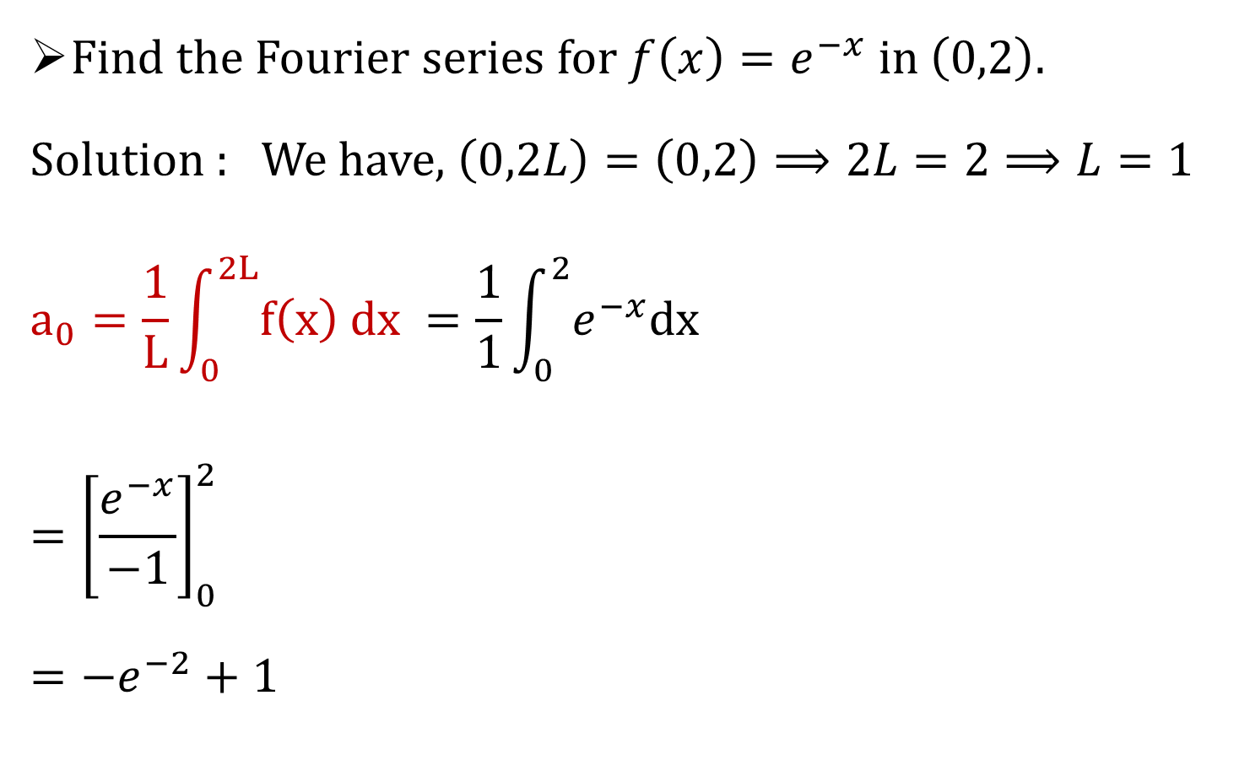
Example 3
Find the Fourier series for $f\left(x\right)=e^{−x}$ in$\left(0,2\right).$
Solution : We have, $\left(0,2L\right)=\left(0,2\right)⟹2L=2⟹L=1$
$$a_{0}=\frac{1}{L}\int_{0}^{2L}{f\left(x\right) dx} =\frac{1}{1}\int_{0}^{2}{e^{−x}dx}$$
$$={\left[\frac{e^{−x}}{−1}\right]}_{0}^{2}$$
$$={−e}^{−2}+1$$

Slide 23
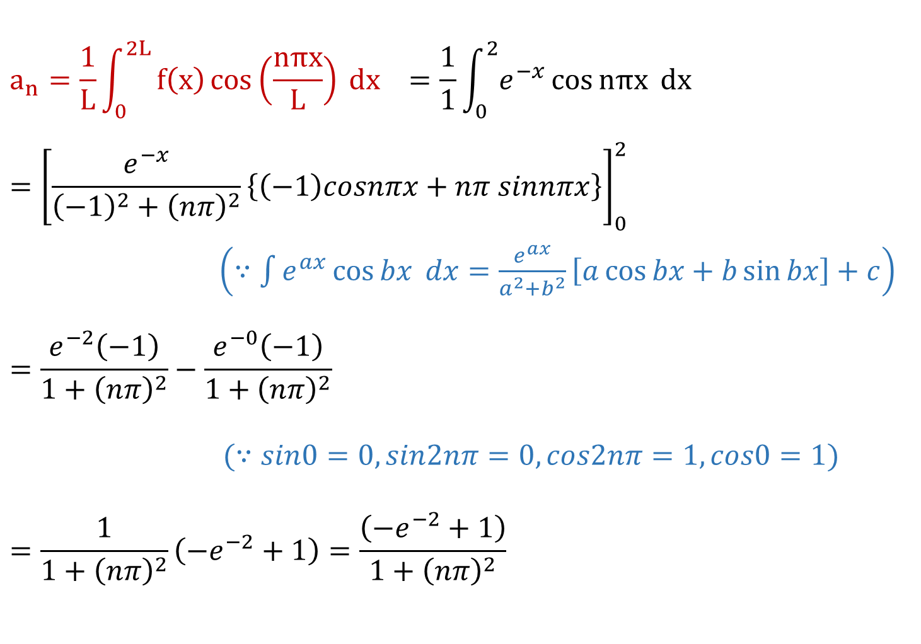
$$a_{n}=\frac{1}{L}\int_{0}^{2L}{f\left(x\right)\cos\left(\frac{nπx}{L}\right) dx} =\frac{1}{1}\int_{0}^{2}{e^{−x}\cos{nπx} dx}$$
$$={\left[\frac{e^{−x}}{{\left(−1\right)}^{2}+{\left(nπ\right)}^{2}}\left\{\left(−1\right)cosnπx+nπ sinnπx\right\}\right]}_{0}^{2}$$
$\left(∵\int{e^{ax}}\cos{bx} dx=\frac{e^{ax}}{a^{2}+b^{2}}\left[a\cos{bx}+b\sin{bx}\right]+c\right)$
$$=\frac{e^{−2}\left(−1\right)}{1+{\left(nπ\right)}^{2}}−\frac{e^{−0}\left(−1\right)}{1+{\left(nπ\right)}^{2}}$$
$(∵sin0=0,sin2nπ=0,cos2nπ=1,cos0=1)$
$$=\frac{1}{1+{\left(nπ\right)}^{2}}\left(−e^{−2}+1\right)=\frac{\left(−e^{−2}+1\right)}{1+{\left(nπ\right)}^{2}}$$

Slide 24
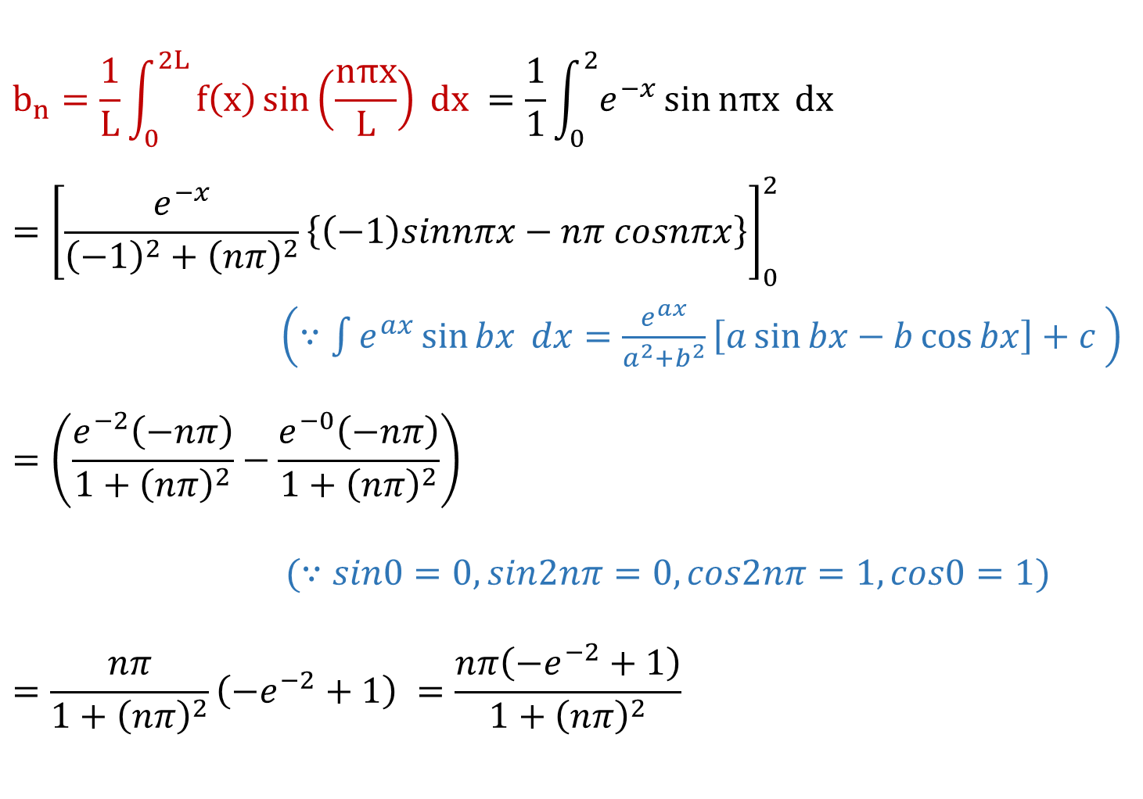
$$b_{n}=\frac{1}{L}\int_{0}^{2L}{f\left(x\right)\sin\left(\frac{nπx}{L}\right) dx} =\frac{1}{1}\int_{0}^{2}{e^{−x}\sin{nπx} dx}$$
$$={\left[\frac{e^{−x}}{{\left(−1\right)}^{2}+{\left(nπ\right)}^{2}}\left\{\left(−1\right)sinnπx−nπ cosnπx\right\}\right]}_{0}^{2}$$
$\left(∵\int{e^{ax}}\sin{bx} dx=\frac{e^{ax}}{a^{2}+b^{2}}\left[a\sin{bx}−b\cos{bx}\right]+c \right)$
$$=\left(\frac{e^{−2}\left(−nπ\right)}{1+{\left(nπ\right)}^{2}}−\frac{e^{−0}\left(−nπ\right)}{1+{\left(nπ\right)}^{2}}\right)$$
$(∵sin0=0,sin2nπ=0,cos2nπ=1,cos0=1)$
$$=\frac{nπ}{1+{\left(nπ\right)}^{2}}\left(−e^{−2}+1\right) =\frac{nπ\left(−e^{−2}+1\right)}{1+{\left(nπ\right)}^{2}}$$

Slide 25
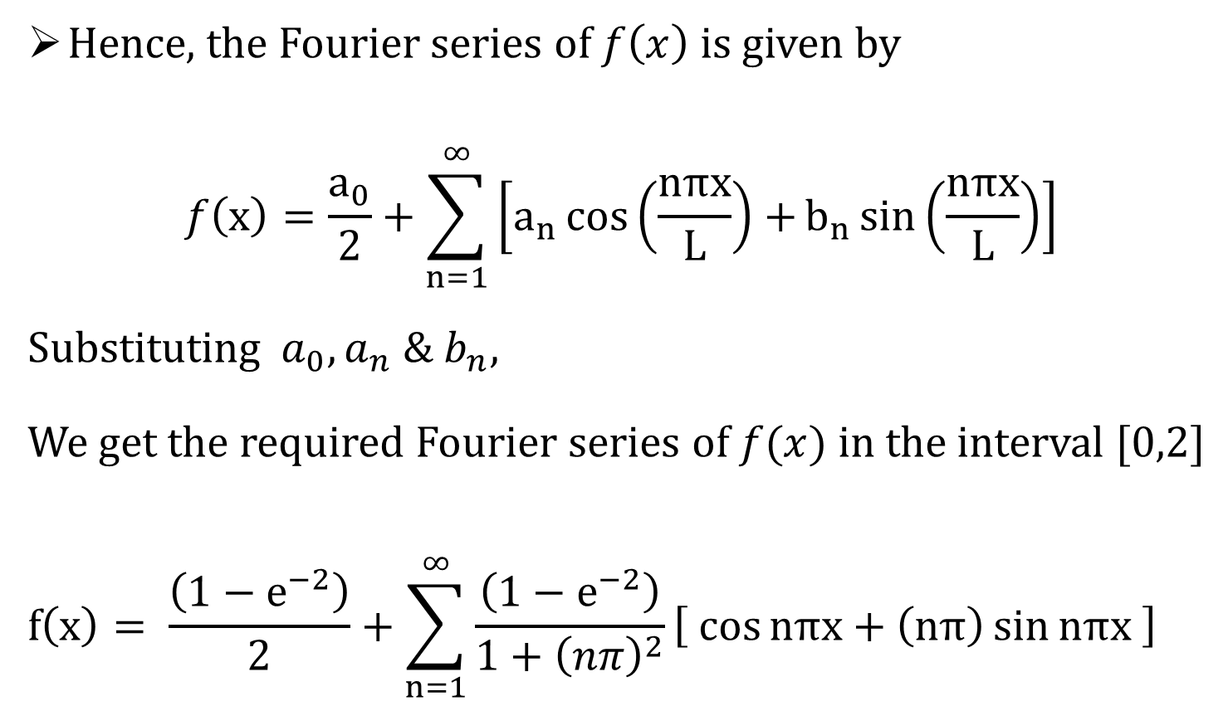
Hence, the Fourier series of $f\left(x\right)$ is given by
$$f\left(x\right)=\frac{a_{0}}{2}+\sum_{n=1}^{∞}{\left[a_{n}\cos\left(\frac{nπx}{L}\right)+b_{n}\sin\left(\frac{nπx}{L}\right)\right]}$$
Substituting $a_{0},a_{n} \& b_{n}$,
We get the required Fourier series of $f(x)$ in the interval $[0,2]$
$$f\left(x\right)= \frac{\left(1−e^{−2}\right)}{2}+\sum_{n=1}^{∞}{\frac{\left(1−e^{−2}\right)}{{1+\left(nπ\right)}^{2}}\left[ \cos{nπx}+\left(nπ\right)\sin{nπx} \right]}$$

Slide 26
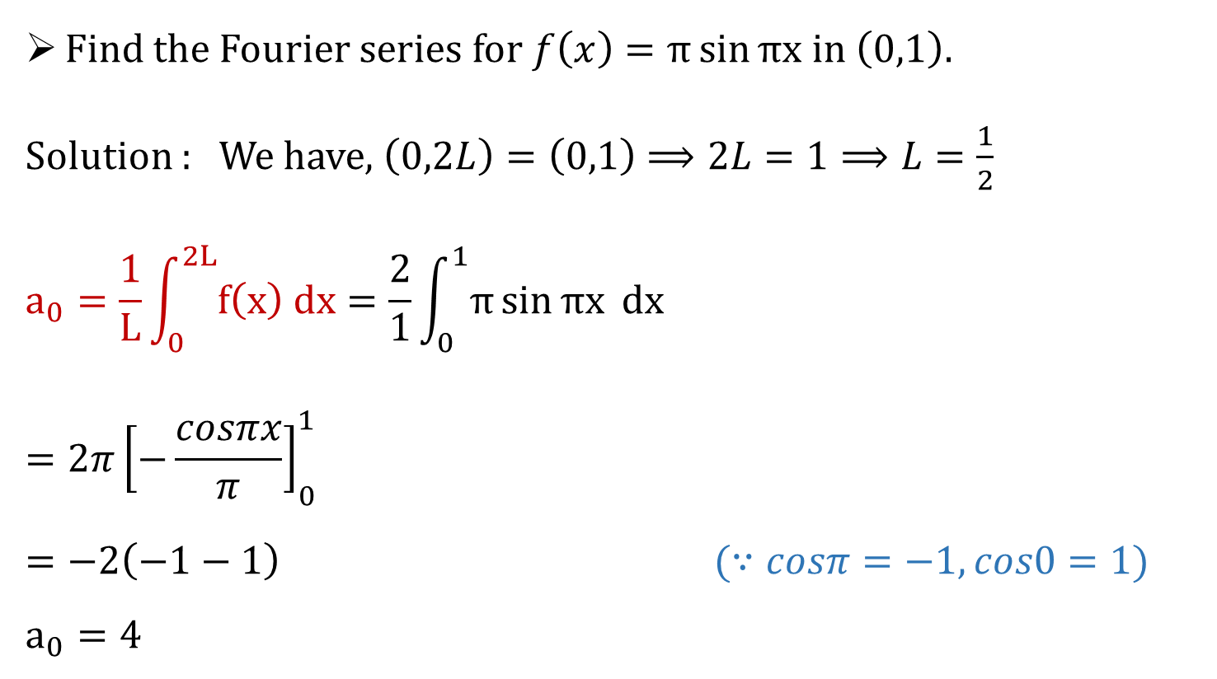
Example 4
Find the Fourier series for $f\left(x\right)=π\sin{πx}$ in$\left(0,1\right).$
Solution : We have, $\left(0,2L\right)=\left(0,1\right)⟹2L=1⟹L=\frac{1}{2}$
$$a_{0}=\frac{1}{L}\int_{0}^{2L}{f\left(x\right) dx}=\frac{2}{1}\int_{0}^{1}{π\sin{πx} dx}$$
$$=2π{\left[−\frac{cosπx}{π}\right]}_{0}^{1}$$
$$=−2\left(−1−1\right) (∵cosπ=−1,cos0=1)$$
$$a_{0}=4$$

Slide 27
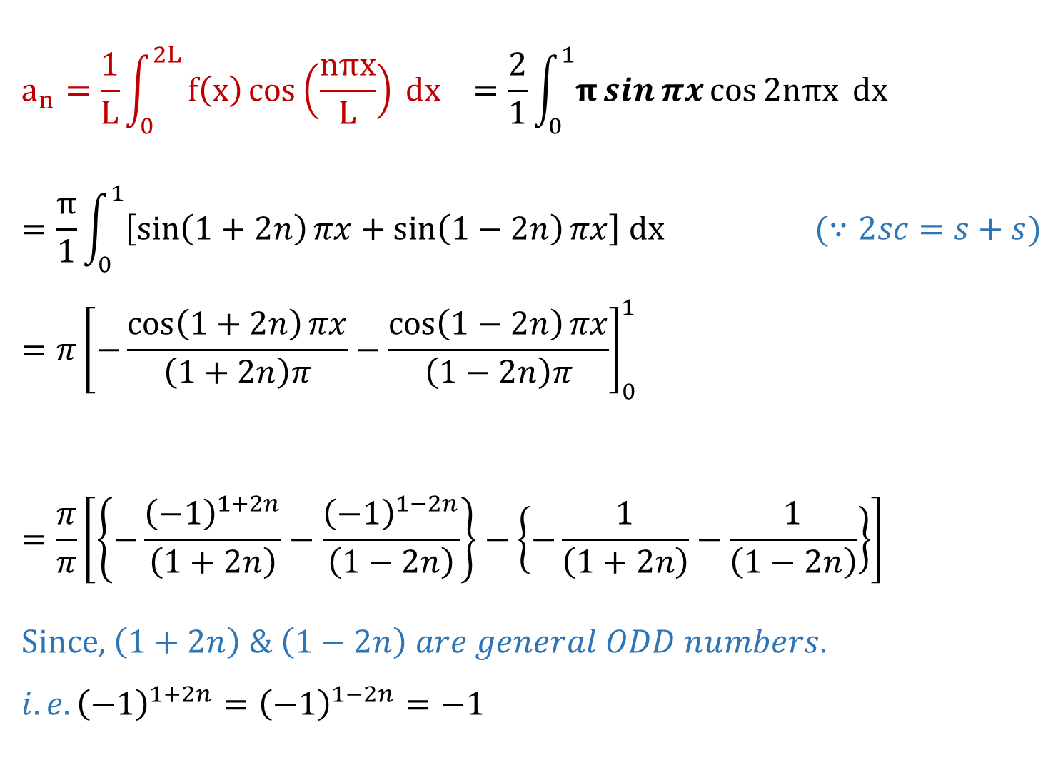
$$a_{n}=\frac{1}{L}\int_{0}^{2L}{f\left(x\right)\cos\left(\frac{nπx}{L}\right) dx} =\frac{2}{1}\int_{0}^{1}{π\sin{πx}\cos{2nπx} dx}$$
$$=\frac{π}{1}\int_{0}^{1}{\left[\sin\left(1+2n\right)πx+\sin\left(1−2n\right)πx\right] dx} (∵2sc=s+s)$$
$$={π\left[−\frac{\cos\left(1+2n\right)πx}{\left(1+2n\right)π}−\frac{\cos\left(1−2n\right)πx}{\left(1−2n\right)π}\right]}_{0}^{1}$$
$$=\frac{π}{π}\left[\left\{−\frac{{\left(−1\right)}^{1+2n}}{\left(1+2n\right)}−\frac{{\left(−1\right)}^{1−2n}}{\left(1−2n\right)}\right\}−\left\{−\frac{1}{\left(1+2n\right)}−\frac{1}{\left(1−2n\right)}\right\}\right]$$
Since, $\left(1+2n\right) \& \left(1−2n\right) are general ODD numbers.$
$$i.e.{\left(−1\right)}^{1+2n}={\left(−1\right)}^{1−2n}=−1$$
$$\left(∵\cos{nπ}={\left(−1\right)}^{n},\cos\left(1+2n\right)π={\left(−1\right)}^{1+2n}\right)$$

Slide 28
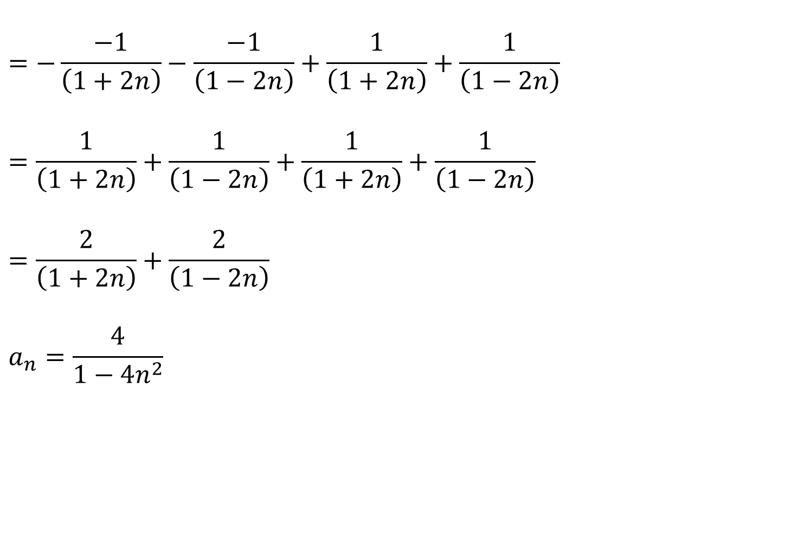
$$=−\frac{−1}{\left(1+2n\right)}−\frac{−1}{\left(1−2n\right)}+\frac{1}{\left(1+2n\right)}+\frac{1}{\left(1−2n\right)}$$
$$=\frac{1}{\left(1+2n\right)}+\frac{1}{\left(1−2n\right)}+\frac{1}{\left(1+2n\right)}+\frac{1}{\left(1−2n\right)}$$
$$=\frac{2}{\left(1+2n\right)}+\frac{2}{\left(1−2n\right)}$$
$$a_{n}=\frac{4}{1−4n^{2}}$$

Slide 29
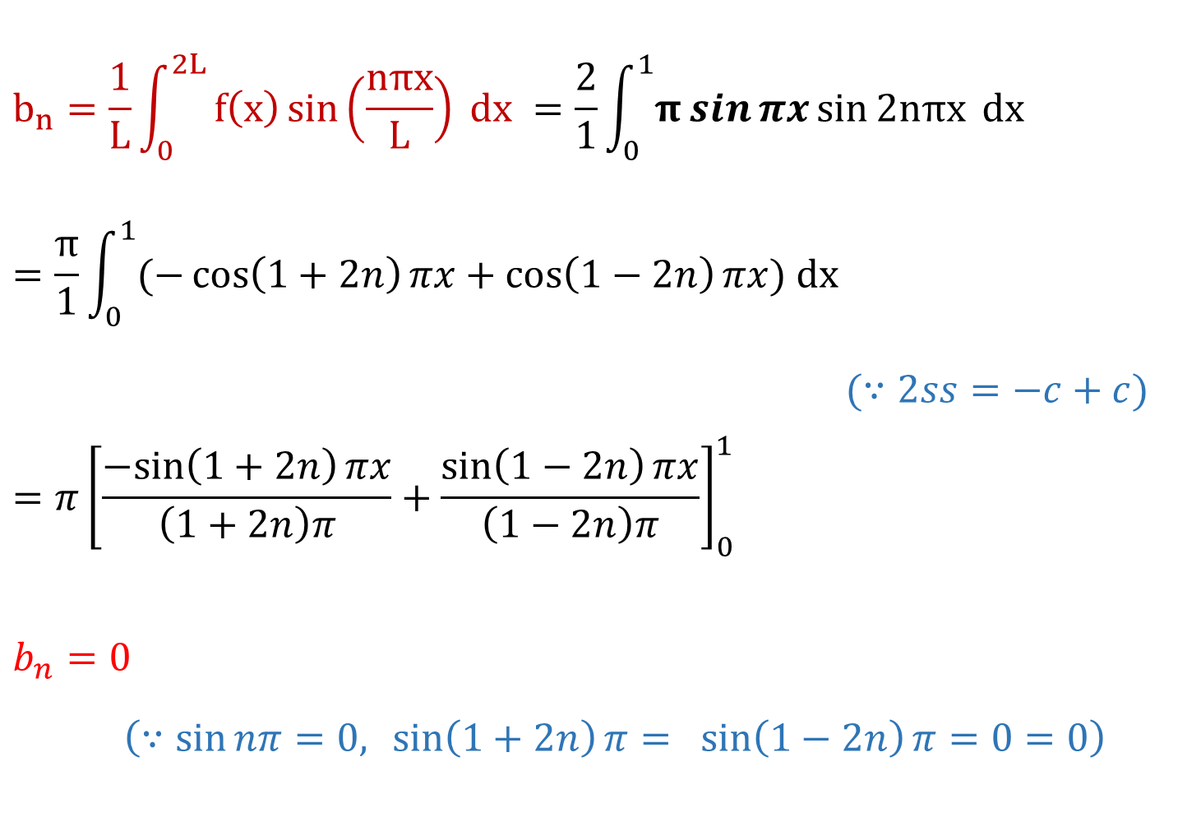
$$b_{n}=\frac{1}{L}\int_{0}^{2L}{f\left(x\right)\sin\left(\frac{nπx}{L}\right) dx} =\frac{2}{1}\int_{0}^{1}{π\sin{πx}\sin{2nπx} dx}$$
$$=\frac{π}{1}\int_{0}^{1}{(−\cos\left(1+2n\right)πx+\cos\left(1−2n\right)πx) dx}$$
$(∵2ss=−c+c)$
$$={π\left[\frac{−sin\left(1+2n\right)πx}{\left(1+2n\right)π}+\frac{\sin\left(1−2n\right)πx}{\left(1−2n\right)π}\right]}_{0}^{1}$$
$$b_{n}=0$$
$\left(∵\sin{nπ}=0,\sin\left(1+2n\right)π=\sin\left(1−2n\right)π=0=0\right)$

Slide 30
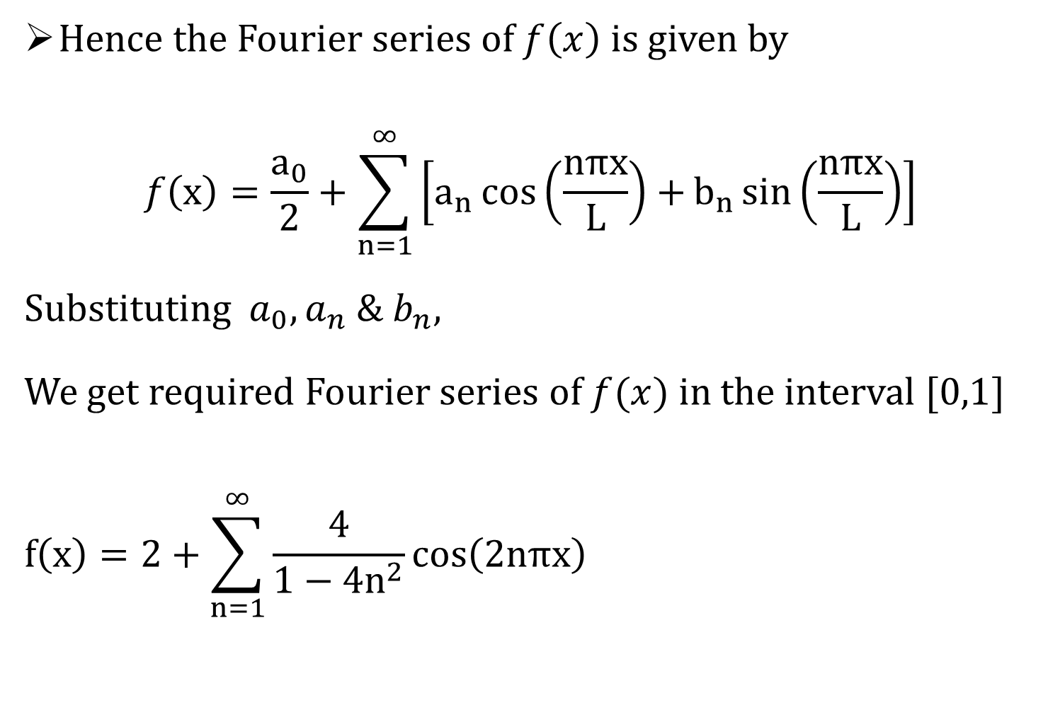
Hence the Fourier series of $f\left(x\right)$ is given by
$$f\left(x\right)=\frac{a_{0}}{2}+\sum_{n=1}^{∞}{\left[a_{n}\cos\left(\frac{nπx}{L}\right)+b_{n}\sin\left(\frac{nπx}{L}\right)\right]}$$
Substituting $a_{0},a_{n} \& b_{n}$,
We get required Fourier series of $f(x)$ in the interval $[0,1]$
$$f\left(x\right)=2+\sum_{n=1}^{∞}{\frac{4}{1−4n^{2}}\cos\left(2nπx\right)}$$

Slide 31
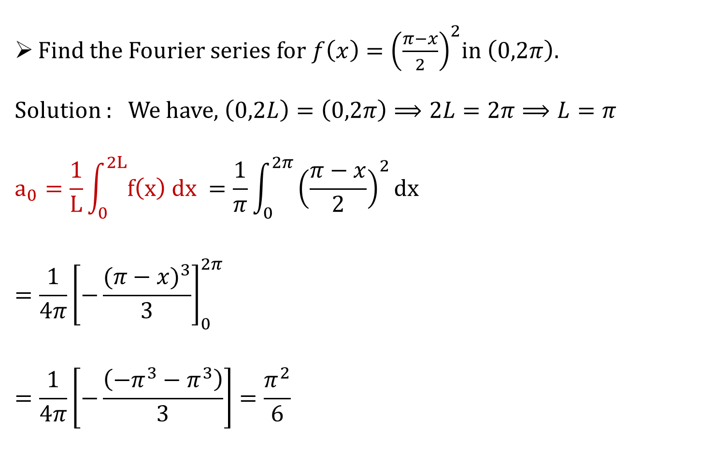
Example 3
Find the Fourier series for $f\left(x\right)={\left(\frac{π−x}{2}\right)}^{2}$in$\left(0,2π\right).$
Solution : We have, $\left(0,2L\right)=\left(0,2π\right)⟹2L=2π⟹L=π$
$$a_{0}=\frac{1}{L}\int_{0}^{2L}{f\left(x\right) dx} =\frac{1}{π}\int_{0}^{2π}{{\left(\frac{π−x}{2}\right)}^{2}dx}$$
$$=\frac{1}{4π}{\left[−\frac{{(π−x)}^{3}}{3}\right]}_{0}^{2π}$$
$$=\frac{1}{4π}\left[−\frac{\left(−π^{3}−π^{3}\right)}{3}\right]=\frac{π^{2}}{6}$$

Slide 32
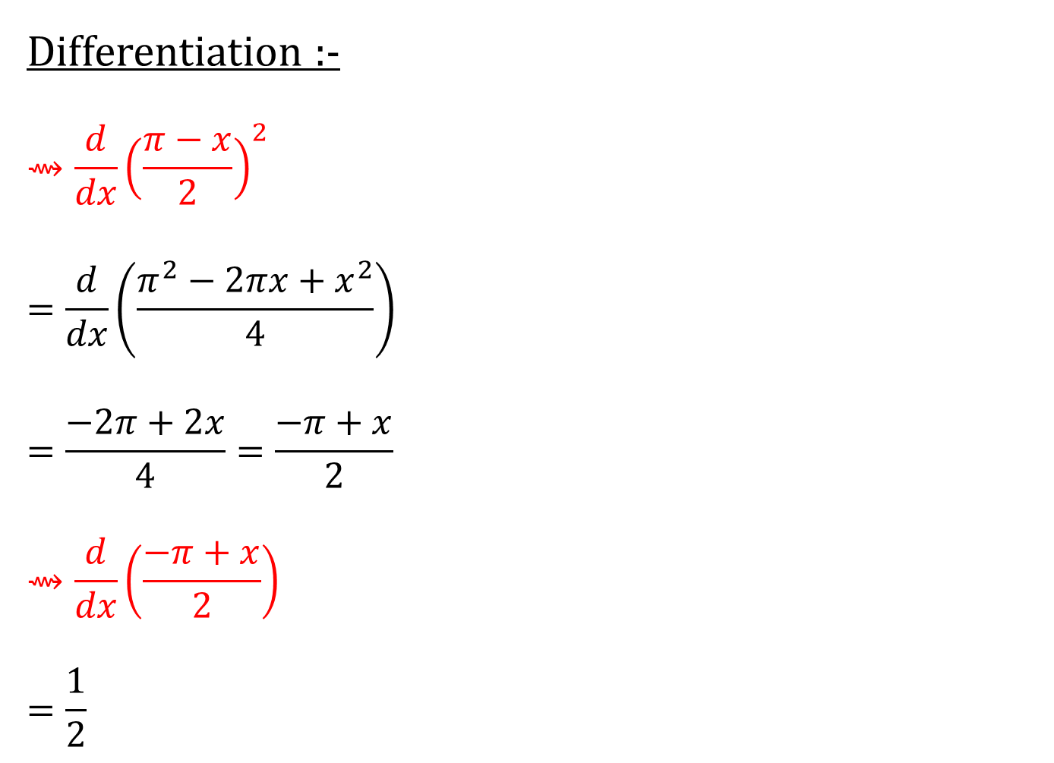
Differentiation :-
$$⇝\frac{d}{dx}{\left(\frac{π−x}{2}\right)}^{2}$$
$$=\frac{d}{dx}\left(\frac{π^{2}−2πx+x^{2}}{4}\right)$$
$$=\frac{−2π+2x}{4}=\frac{−π+x}{2}$$
$$⇝\frac{d}{dx}\left(\frac{−π+x}{2}\right)$$
$$=\frac{1}{2}$$

Slide 33
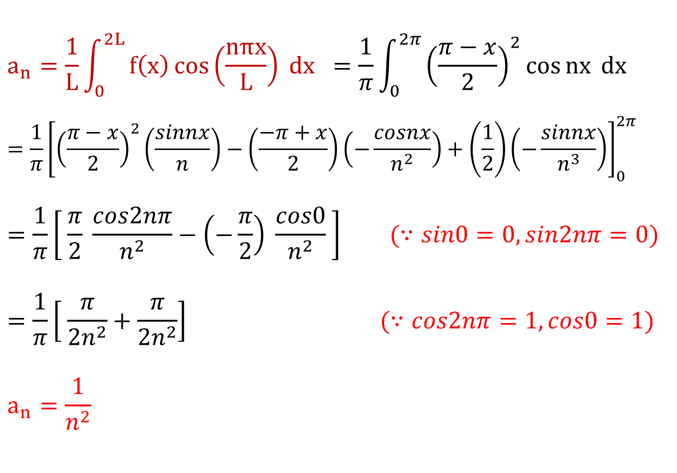
$$a_{n}=\frac{1}{L}\int_{0}^{2L}{f\left(x\right)\cos\left(\frac{nπx}{L}\right) dx} =\frac{1}{π}\int_{0}^{2π}{{\left(\frac{π−x}{2}\right)}^{2}\cos{nx} dx}$$
$$={\frac{1}{π}\left[{\left(\frac{π−x}{2}\right)}^{2}\left(\frac{sinnx}{n}\right)−\left(\frac{−π+x}{2}\right)\left(−\frac{cosnx}{n^{2}}\right)+\left(\frac{1}{2}\right)\left(−\frac{sinnx}{n^{3}}\right)\right]}_{0}^{2π}$$
$$=\frac{1}{π}\left[ \frac{π}{2} \frac{cos2nπ}{n^{2}}−\left(−\frac{π}{2}\right) \frac{cos0}{n^{2}} \right] (∵sin0=0,sin2nπ=0)$$
$$=\frac{1}{π}\left[ \frac{π}{2n^{2}}+\frac{π}{2n^{2}}\right] (∵cos2nπ=1,cos0=1)$$
$$a_{n}=\frac{1}{n^{2}}$$

Slide 34
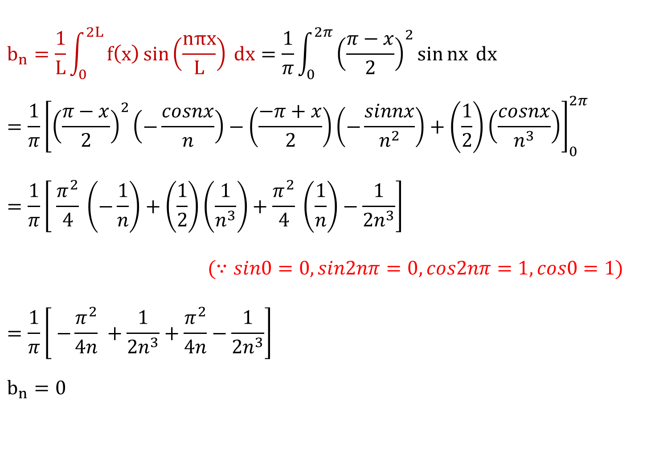
$$b_{n}=\frac{1}{L}\int_{0}^{2L}{f\left(x\right)\sin\left(\frac{nπx}{L}\right) dx}=\frac{1}{π}\int_{0}^{2π}{{\left(\frac{π−x}{2}\right)}^{2}\sin{nx} dx}$$
$$={\frac{1}{π}\left[{\left(\frac{π−x}{2}\right)}^{2}\left(−\frac{cosnx}{n}\right)−\left(\frac{−π+x}{2}\right)\left(−\frac{sinnx}{n^{2}}\right)+\left(\frac{1}{2}\right)\left(\frac{cosnx}{n^{3}}\right)\right]}_{0}^{2π}$$
$$=\frac{1}{π}\left[ \frac{π^{2}}{4} \left(−\frac{1}{n}\right)+\left(\frac{1}{2}\right)\left(\frac{1}{n^{3}}\right)+\frac{π^{2}}{4} \left(\frac{1}{n}\right)−\frac{1}{{2n}^{3}}\right]$$
$(∵sin0=0,sin2nπ=0,cos2nπ=1,cos0=1)$
$$=\frac{1}{π}\left[ −\frac{π^{2}}{4n} +\frac{1}{{2n}^{3}}+\frac{π^{2}}{4n}−\frac{1}{{2n}^{3}}\right]$$
$$b_{n}=0$$

Slide 35
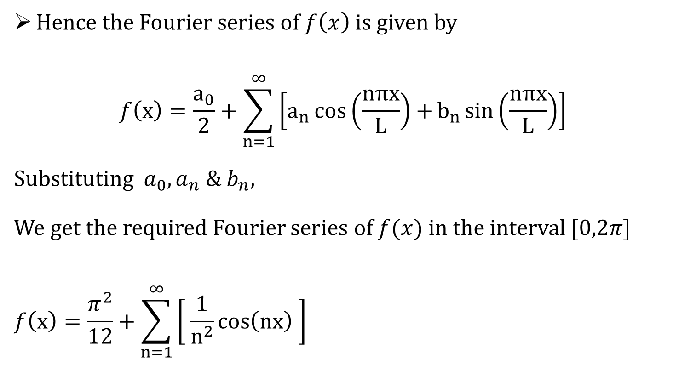
Hence the Fourier series of $f\left(x\right)$ is given by
$$f\left(x\right)=\frac{a_{0}}{2}+\sum_{n=1}^{∞}{\left[a_{n}\cos\left(\frac{nπx}{L}\right)+b_{n}\sin\left(\frac{nπx}{L}\right)\right]}$$
Substituting $a_{0},a_{n} \& b_{n}$,
We get the required Fourier series of $f(x)$ in the interval $[0,2π]$
$$f\left(x\right)=\frac{π^{2}}{12}+\sum_{n=1}^{∞}{\left[ \frac{1}{n^{2}}\cos\left(nx\right) \right]}$$

Slide 36
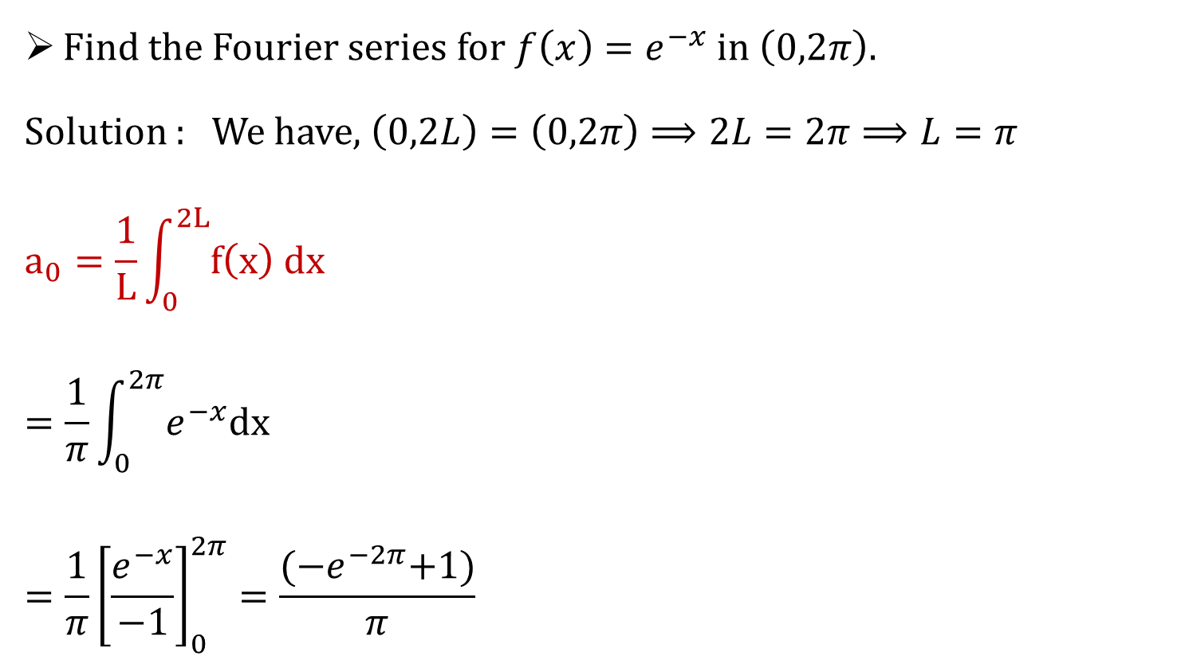
Example 4
Find the Fourier series for $f\left(x\right)=e^{−x}$ in$\left(0,2π\right).$
Solution : We have, $\left(0,2L\right)=\left(0,2π\right)⟹2L=2π⟹L=π$
$$a_{0}=\frac{1}{L}\int_{0}^{2L}{f\left(x\right) dx}$$
$$=\frac{1}{π}\int_{0}^{2π}{e^{−x}dx}$$
$$={\frac{1}{π}\left[\frac{e^{−x}}{−1}\right]}_{0}^{2π}=\frac{{(−e}^{−2π}+1)}{π}$$

Slide 37
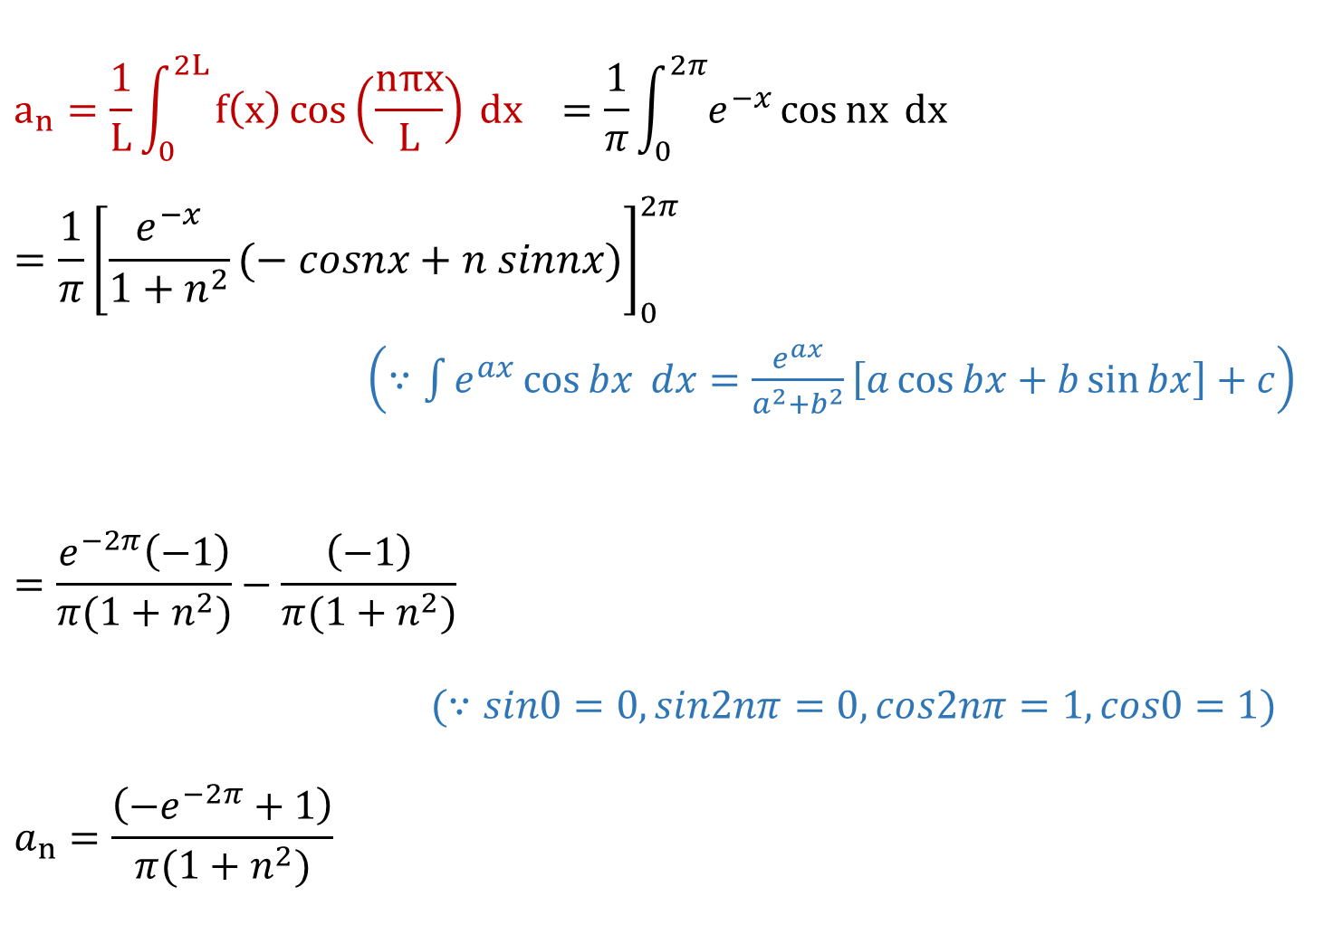
$$a_{n}=\frac{1}{L}\int_{0}^{2L}{f\left(x\right)\cos\left(\frac{nπx}{L}\right) dx} =\frac{1}{π}\int_{0}^{2π}{e^{−x}\cos{nx} dx}$$
$$=\frac{1}{π}{\left[\frac{e^{−x}}{1+n^{2}}(− cosnx+n sinnx)\right]}_{0}^{2π}$$
$\left(∵\int{e^{ax}}\cos{bx} dx=\frac{e^{ax}}{a^{2}+b^{2}}\left[a\cos{bx}+b\sin{bx}\right]+c\right)$
$$=\frac{e^{−2π}\left(−1\right)}{π(1+n^{2})}−\frac{\left(−1\right)}{π(1+n^{2})}$$
$(∵sin0=0,sin2nπ=0,cos2nπ=1,cos0=1)$
$$a_{n}=\frac{\left(−e^{−2π}+1\right)}{π(1+n^{2})}$$

Slide 38
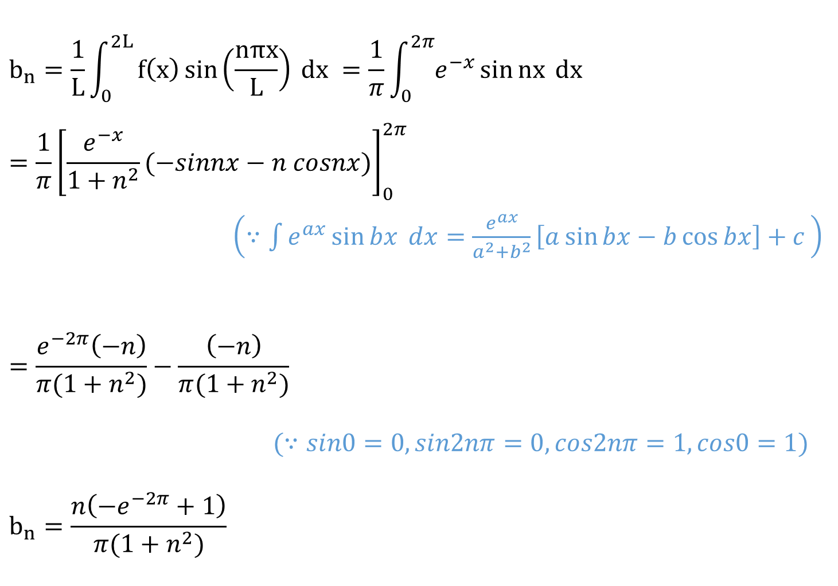
$$b_{n}=\frac{1}{L}\int_{0}^{2L}{f\left(x\right)\sin\left(\frac{nπx}{L}\right) dx} =\frac{1}{π}\int_{0}^{2π}{e^{−x}\sin{nx} dx}$$
$$=\frac{1}{π}{\left[\frac{e^{−x}}{1+n^{2}}(−sinnx−n cosnx)\right]}_{0}^{2π}$$
$\left(∵\int{e^{ax}}\sin{bx} dx=\frac{e^{ax}}{a^{2}+b^{2}}\left[a\sin{bx}−b\cos{bx}\right]+c \right)$
$$=\frac{e^{−2π}\left(−n\right)}{π(1+n^{2})}−\frac{\left(−n\right)}{π(1+n^{2})}$$
$(∵sin0=0,sin2nπ=0,cos2nπ=1,cos0=1)$
$$b_{n}=\frac{n\left(−e^{−2π}+1\right)}{π(1+n^{2})}$$

Slide 39
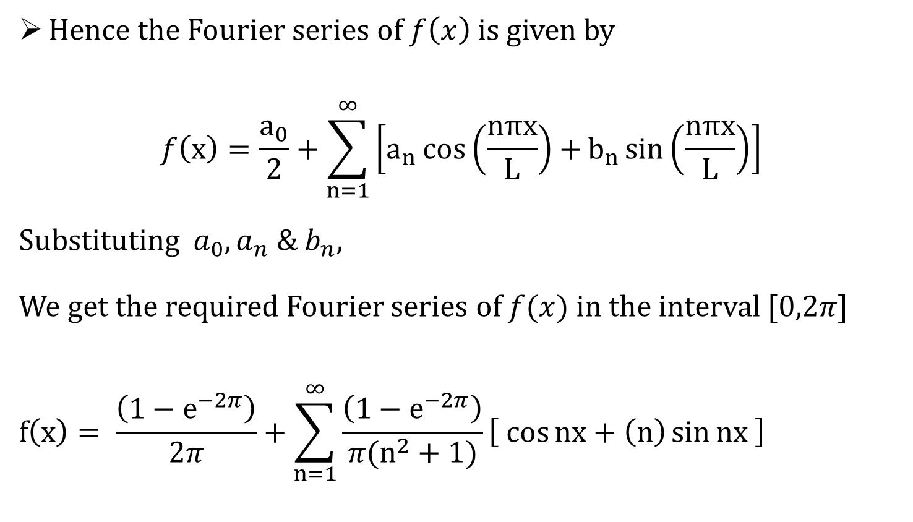
Hence the Fourier series of $f\left(x\right)$ is given by
$$f\left(x\right)=\frac{a_{0}}{2}+\sum_{n=1}^{∞}{\left[a_{n}\cos\left(\frac{nπx}{L}\right)+b_{n}\sin\left(\frac{nπx}{L}\right)\right]}$$
Substituting $a_{0},a_{n} \& b_{n}$,
We get the required Fourier series of $f(x)$ in the interval $[0,2π]$
$$f\left(x\right)= \frac{\left(1−e^{−2π}\right)}{2π}+\sum_{n=1}^{∞}{\frac{\left(1−e^{−2π}\right)}{{π(n}^{2}+1)}\left[ \cos{nx}+\left(n\right)\sin{nx} \right]}$$

Slide 40
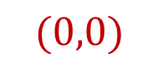
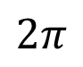





Example 7
Determine the Fourier series to represent
the periodic function as shown in the figure.
$$f(x)$$
$$(2π,π)$$
$$π$$
$$x$$
$$(0,0)$$
$$2π$$
$$4π$$

Slide 41

Example 7
Solution :
Line passing through two points$\left(x_{0},y_{0}\right)=(0,0)$ & $\left(x_{1},y_{1}\right)=(2π,π)$
$$\frac{y−y_{0}}{x−x_{0}}=\frac{y_{1}−y_{0}}{x_{1}−x_{0}}$$
$$⟹ \frac{y}{x}=\frac{π}{2π}$$
$$⟹y=\frac{x}{2}$$

Slide 42

Here, $f\left(x\right)=\frac{x}{2}$ with period $2π$
Now, $2L=2π⟹L=π$
$$a_{0}=\frac{1}{L}\int_{0}^{2L}{f\left(x\right) dx}=\frac{1}{π}\int_{0}^{2π}{ \frac{x}{2} dx=\frac{1}{2π}\int_{0}^{2π}{x dx}}$$
$$=\frac{1}{2π}{\left[\frac{x^{2}}{2}\right]}_{0}^{2π}$$
$$=\frac{1}{2π}\left[\frac{{4π}^{2}}{2}\right]⟹a_{0}=π$$

Slide 43

$$a_{n}=\frac{1}{L}\int_{0}^{2L}{f\left(x\right)\cos\left(\frac{nπx}{L}\right) dx} =\frac{1}{π}\int_{0}^{2π}{\frac{x}{2} \cos{nx} dx}$$
$$={\frac{1}{π}\left[\frac{x}{2}\left(\frac{sinnx}{n}\right)−\left(\frac{1}{2}\right)\left(−\frac{cosnx}{n^{2}}\right)\right]}_{0}^{2π}$$
$$={\frac{1}{2π}\left[\frac{cosnx}{n^{2}}\right]}_{0}^{2π} (∵sin0=0,sin2nπ=0)$$
$$=\frac{1}{2π}\left[ \frac{cos2nπ}{n^{2}}−\frac{cos0}{n^{2}} \right]$$
$$=\frac{1}{2π}\left[ \frac{1}{n^{2}} −\frac{1}{n^{2}} \right] (∵cos2nπ=1,cos0=1)$$
$$a_{n}=0$$

Slide 44

$$b_{n}=\frac{1}{L}\int_{0}^{2L}{f\left(x\right)\sin\left(\frac{nπx}{L}\right) dx}=\frac{1}{π}\int_{0}^{2π}{\frac{x}{2} \sin{nx} dx}$$
$$={\frac{1}{π}\left[\frac{x}{2}\left(−\frac{cosnx}{n}\right)−\left(\frac{1}{2}\right)\left(−\frac{sinnx}{n^{2}}\right)\right]}_{0}^{2π}$$
$$={\frac{1}{π}\left[\frac{x}{2}\left(−\frac{cosnx}{n}\right)\right]}_{0}^{2π} (∵sin0=0,sin2nπ=0)$$
$$=−\frac{1}{2nπ}\left[2π (cos2nπ)\right] (cos2nπ=1,cos0=1)$$
$$b_{n}=−\frac{1}{n}$$

Slide 45

Hence the Fourier series of $f\left(x\right)$ is given by
$$f\left(x\right)=\frac{a_{0}}{2}+\sum_{n=1}^{∞}{\left[a_{n}\cos\left(\frac{nπx}{L}\right)+b_{n}\sin\left(\frac{nπx}{L}\right)\right]}$$
Substituting $a_{0},a_{n} \& b_{n}$,
We get the required Fourier series of $f(x)$ in the interval $[0,2π]$
$$f\left(x\right)=\frac{π}{2}−\sum_{n=1}^{∞}{\left[ \frac{1}{n}\sin\left(nx\right) \right]}$$

Slide 46

Example 6
Find the Fourier Series for the function $f\left(x\right)$ given by
$$f\left(x\right)=\left\{\begin{aligned}−π , 0<x<π \\ \\ x−π , π<x<2π \end{aligned}\right.$$
Solution : We have, $\left(0,2L\right)=\left(0,2π\right)⟹2L=2π⟹L=π$
$$a_{0}=\frac{1}{L}\int_{0}^{2L}{f\left(x\right) dx=\frac{1}{π}\int_{0}^{2π}{f\left(x\right) dx}}$$
$$=\frac{1}{π}\left[\int_{0}^{π}{ −π dx+}\int_{π}^{2π}{ (x−π )dx}\right]$$

Slide 47

$$a_{0}=\frac{1}{π}\left[\int_{0}^{π}{ −π dx+}\int_{π}^{2π}{ (x−π )dx}\right]$$
$$=\frac{1}{π}\left[{\left(−πx\right)}_{0}^{π}+{\left(\frac{x^{2}}{2}−πx\right)}_{π}^{2π}\right]$$
$$=\frac{1}{π}\left[\left(−π^{2}\right)+\left(\frac{4π^{2}}{2}−2π^{2}−\frac{π^{2}}{2}+π^{2}\right)\right]$$
$$=\frac{1}{π}\left[−π^{2}+2π^{2}−2π^{2}−\frac{π^{2}}{2}+π^{2}\right]⟹a_{0}=−\frac{π}{2}$$

Slide 48

$$a_{n}=\frac{1}{L}\int_{0}^{2L}{f\left(x\right)\cos\left(\frac{nπx}{L}\right) dx} =\frac{1}{π}\int_{0}^{2π}{f(x) \cos{nx} dx}$$
$$=\frac{1}{π}\left[\int_{0}^{π}{ −π\cos{nx}dx+}\int_{π}^{2π}{ (x−π )\cos{nx}dx}\right]$$
$$=\frac{1}{π}\left[−π{\left(\frac{\sin{nx}}{n}\right)}_{0}^{π}+{\left(\left\{x−π\right\}\frac{\sin{nx}}{n}−\left\{1\right\}\frac{−cos{nx}}{n^{2}}\right)}_{π}^{2π}\right]$$
$(∵sin0=0,sin2nπ=0)$
$$=\frac{1}{π}\left[ \frac{cos2nπ}{n^{2}}−\frac{cosnπ}{n^{2}} \right] (∵cos2nπ=1,cosnπ={\left(−1\right)}^{n})$$
$$=\frac{1}{π}\left[ \frac{1}{n^{2}} −\frac{{\left(−1\right)}^{n}}{n^{2}} \right]⟹a_{n}=\frac{1}{πn^{2}}(1−{\left(−1\right)}^{n})$$

Slide 49

$$b_{n}=\frac{1}{L}\int_{0}^{2L}{f\left(x\right)\sin\left(\frac{nπx}{L}\right) dx} =\frac{1}{π}\int_{0}^{2π}{f(x) \sin{nx} dx}$$
$$=\frac{1}{π}\left[\int_{0}^{π}{ −π\sin{nx}dx+}\int_{π}^{2π}{ (x−π )\sin{nx}dx}\right]$$
$$=\frac{1}{π}\left[−π{\left(\frac{−\cos{nx}}{n}\right)}_{0}^{π}+{\left(\left\{x−π\right\}\frac{−\cos{nx}}{n}−\left\{1\right\}\frac{−sin{nx}}{n^{2}}\right)}_{π}^{2π}\right]$$
$(∵sin0=0,sin2nπ=0)$
$$=\frac{1}{π}\left[π\left( \frac{cosnπ}{n}−\frac{cos0}{n} \right)+\left(−π\frac{\cos{2nπ}}{n}\right)\right]$$
$b_{n}=\frac{1}{n}\left[{\left(−1\right)}^{n}−2\right] (∵cos2nπ=cos0=1,cosnπ$ $={\left(−1\right)}^{n})$

Slide 50

Hence the Fourier series of $f\left(x\right)$ is given by
$$f\left(x\right)=\frac{a_{0}}{2}+\sum_{n=1}^{∞}{\left[a_{n}\cos\left(\frac{nπx}{L}\right)+b_{n}\sin\left(\frac{nπx}{L}\right)\right]}$$
Substituting $a_{0},a_{n} \& b_{n}$,
We get the required Fourier series of $f(x)$ in the interval $[0,2π]$
$$f\left(x\right)=−\frac{π}{4}+\frac{1}{π}\sum_{n=1}^{∞}{\left[\frac{1}{n^{2}}\left(1−{\left(−1\right)}^{n}\right)\sin\left(nx\right)+\frac{1}{n}\left({\left(−1\right)}^{n}−2\right)\cos\left(nx\right)\right]}$$

Slide 51

Remark
At a point of discontinuity the sum of the series is equal to average of left and right hand limits of $f(x)$at the point of discontinuity, say $x_{0}.$
$$f\left(x_{0}\right)=\frac{f\left(x_{0}−0\right)+f\left(x_{0}+0\right)}{2}$$
e.g.
$$Find f\left(π\right) for f\left(x\right)=\left\{\begin{aligned}−π , 0<x<π \\ \\ x−π , π<x<2π \end{aligned}\right.$$

Slide 52
Fourier Series in the interval $(−L,L)$
The Fourier series for the function $f(x)$ in the interval $(−L,L)$ is defined by
$$f\left(x\right)=\frac{a_{0}}{2}+\sum_{n=1}^{∞}{\left[a_{n}\cos\left(\frac{nπx}{L}\right)+b_{n}\sin\left(\frac{nπx}{L}\right)\right]}$$
Where the constants${ a}_{0}$, $a_{n}$ and $b_{n}$ are given by
$$a_{0}=\frac{1}{L}\int_{−L}^{L}{f\left(x\right) dx},$$
$$a_{n}=\frac{1}{L}\int_{−L}^{L}{f\left(x\right)\cos\left(\frac{nπx}{L}\right) dx}, b_{n}=\frac{1}{L}\int_{−L}^{L}{f\left(x\right)\sin\left(\frac{nπx}{L}\right) dx}$$

Slide 53

Even Function
A function is said to be Even Function if $f\left(−x\right)=f\left(x\right).$
If $f(x)$ is an even function defined in $(–a,a),$
then $\int_{–a}^{a}{f\left(x\right)} dx=2\int_{0}^{a}{f\left(x\right)} dx.$
e.g.
$x^{2},x^{4},x^{6},… i.e.x^{n},where n is even.$
Every constant is an Even Function.
$cosx$ ,Graph is symmetric about $Y−$axis.

Slide 54






Even Function
A function is said to be Even Function if $f\left(−x\right)=f\left(x\right).$
-ve values of function
$$=f(−x)$$
+ve values of function
$$=f(x)$$
-ve values of $x$
+ve values of $x$
Graph of $f\left(x\right)=\left|x\right|$

Slide 55


Even Function
Graph is symmetric about $Y−$axis.
Graph of $f\left(x\right)=\left|x\right|$

Slide 56

Odd Function
A function is said to be Odd Function if $f(−x)=−f(x).$
If $f(x)$ is an odd function defined in $(–a,a),$
then $\int_{–a}^{a}{f\left(x\right)} dx=0.$
e.g.
$x,x^{3},x^{5},… i.e.x^{m},where m is odd.$
$sinx$ , Graph is symmetric about Origin.

Slide 57






Odd Function
A function is said to be Even Function if $f\left(−x\right)=−f\left(x\right)$
+ve values of function
$$=f(x)$$
-ve values of $x$
-ve values of function
$$=f(−x)$$
+ve values of $x$
Graph of $f\left(x\right)=x$

Slide 58


odd Function
Graph is symmetric about $Origin$.
Graph of $f\left(x\right)=x$

Slide 59


Fourier Series For Even Function
Let, $f(x)$ be a periodic function defined in $(−L,L)$
$f(x)$ is even, $b_{n}=0;n=1,2,3,…$
Where,
$$a_{0}=\frac{2}{L}\int_{0}^{L}{f\left(x\right) dx}$$
$$a_{n}=\frac{2}{L}\int_{0}^{L}{f\left(x\right)\cos\left(\frac{nπx}{L}\right) dx}$$
$$f\left(x\right)=\frac{a_{0}}{2}+\sum_{n=1}^{∞}{a_{n}\cos\left(\frac{nπx}{L}\right)}$$

Slide 60


Fourier Series For Odd Function
Let, $f(x)$ be a periodic function defined in $(−L,L)$
$f(x)$ is odd, $a_{0}=a_{n}=0 ;n=1,2,3,…$
Where,
$$b_{n}=\frac{2}{L}\int_{0}^{L}{f\left(x\right)\sin\left(\frac{nπx}{L}\right) dx}$$
$$f\left(x\right)=\sum_{n=1}^{∞}{b_{n}\sin\left(\frac{nπx}{L}\right)}$$

Slide 61


Example 1
Find the Fourier series of the periodic function $f(x)=2x.$ Where $−1<x<1 ,p=2l=2.$
Solution : We have, $\left(−L,L\right)=\left(−1,1\right)⟹L=1$
The given function is odd function as it is defined on symmetric interval and it will satisfy $f(−x)=−f(x)$.
Fourier Series for Odd Function is given by
$$f\left(x\right)=\sum_{n=1}^{∞}{b_{n}\sin\left(\frac{nπx}{L}\right)}$$

Slide 62






$$b_{n}=\frac{2}{L}\int_{0}^{L}{f\left(x\right)\sin\left(\frac{nπx}{L}\right) dx}=\frac{2}{1}\int_{0}^{1}{2x\sin{nπx} dx}$$
$$=4\int_{0}^{1}{x\sin{nπx}dx}$$
$$=4{\left[\left(− \frac{\cos{}}{n} \right)\right]}_{0}^{1}$$
$$=\left[−\frac{4 cosnπ}{\left(nπ\right)}\right] (∵sin0=0,sinnπ=0)$$
$$b_{n}=\frac{4 {\left(−1\right)}^{n+1}}{nπ} (∵cosnπ={\left(−1\right)}^{n})$$
$$\left(−\frac{\cos{nπx}}{(nπ)}\right)$$
$$\left(−\frac{\sin{nπx}}{{(nπ)}^{2}}\right)$$
$$x$$
$$−$$
$$\left(1\right)$$

Slide 63


Hence the Fourier series of $f\left(x\right)$ is given by
Substituting $b_{n}$,
We get the required Fourier series of $f(x)$ in the interval $[−1,1]$
$$: f\left(x\right)=\sum_{n=1}^{∞}{\frac{4{\left(−1\right)}^{n+1}}{nπ}\sin\left(nπx\right)}$$
$$f\left(x\right)=\sum_{n=1}^{∞}{b_{n}\sin\left(\frac{nπx}{L}\right)}$$

Slide 64


Example 3
Find the Fourier series for $f(x)=x^{2}$ in $−l<x<l$.
Solution : We have, $\left(−L,L\right)=\left(−l,l\right)⟹L=l$
The given function is even function as it is defined on symmetric interval and it will satisfy $f(−x)=f(x)$.
Fourier Series for even Function is given by
$$f\left(x\right)=\frac{a_{0}}{2}+\sum_{n=1}^{∞}{a_{n}\cos\left(\frac{nπx}{L}\right)}$$

Slide 65

$$a_{0}=\frac{2}{L}\int_{0}^{L}{f\left(x\right) dx}$$
$$=\frac{2}{l}\int_{0}^{l}{x^{2} dx}$$
$$=\frac{2}{l}{\left[\frac{x^{3}}{3}\right]}_{0}^{l}$$
$$a_{0}=\frac{2l^{2}}{3}$$

Slide 66

$$a_{n}=\frac{2}{L}\int_{0}^{L}{f\left(x\right)\cos\left(\frac{nπx}{L}\right)dx}=\frac{2}{l}\int_{0}^{l}{x^{2}\cos\left(\frac{nπx}{l}\right)dx}$$
$$={\frac{2}{l}\left[x^{2}\sin\left(\frac{nπx}{l}\right)\left(\frac{l}{nπ}\right)−\left(2x\right)\left(−\cos\left(\frac{nπx}{l}\right)\right){\left(\frac{l}{nπ}\right)}^{2}+\left(2\right)\left(−\sin\left(\frac{nπx}{l}\right){\left(\frac{l}{nπ}\right)}^{3}\right)\right]}_{0}^{l}$$
$$=\frac{2}{l}\left[2l{\left(\frac{l}{nπ}\right)}^{2}cosnπ\right] (∵sin0=0,sinnπ=0)$$
$$a_{n}=\frac{4l^{2} {\left(−1\right)}^{n}}{{\left(nπ\right)}^{2}} (∵cosnπ={\left(−1\right)}^{n})$$

Slide 67


Hence the Fourier series of $f\left(x\right)$ is given by
Substituting$a_{0},a_{n}$,
We get the required Fourier series of $f(x)$ in the interval $[−l,l]$
$$f\left(x\right)=\frac{l^{2}}{3}+\sum_{n=1}^{∞}{\frac{4 l^{2}{\left(−1\right)}^{n}}{n^{2}π^{2}}\cos\left(\frac{nπx}{l}\right)}$$
$$f\left(x\right)=\frac{a_{0}}{2}+\sum_{n=1}^{∞}{a_{n}\cos\left(\frac{nπx}{L}\right)}$$

Slide 68

Example 5
Find the Fourier series of $f\left(x\right)=x+x^{2}$ ,Where $−2<x<2.$
Solution :
Here, $f\left(x\right)=x+x^{2} ; L=2$.
The given function is Neither even nor odd function .

Slide 69

$$a_{0}=\frac{1}{L}\int_{−L}^{L}{f\left(x\right) dx}=\frac{1}{2}\int_{−2}^{2}{\left(x+x^{2}\right) dx}$$
Here, $x$ is an odd function and $x^{2}$ is an even function.
$$=\frac{1}{2}\int_{−2}^{2}{x dx}+\frac{1}{2}\int_{−2}^{2}{x^{2} dx}$$
$$=0+\frac{2}{2}\int_{0}^{2}{x^{2} dx}$$
$$=\frac{2}{2}{\left[\frac{x^{3}}{3}\right]}_{0}^{2}=\left[\frac{8}{3}−0\right]=\frac{8}{3}$$

Slide 70

$$a_{n}=\frac{1}{L}\int_{−L}^{L}{f\left(x\right) cos \left(\frac{nπx}{L}\right)dx}=\frac{1}{2}\int_{−2}^{2}{\left(x+x^{2}\right)\cos\left(\frac{nπx}{2}\right) dx}$$
$$=\frac{1}{2}\int_{−2}^{2}{x \cos\left(\frac{nπx}{2}\right) dx}+\frac{1}{2}\int_{−2}^{2}{x^{2}\cos\left(\frac{nπx}{2}\right) dx}$$
Here, $x\cos\left(\frac{nπx}{2}\right)$ is an odd function and $x^{2}\cos\left(\frac{nπx}{2}\right)$ is an even function.
$$=0+\frac{2}{2}\int_{0}^{2}{x^{2}\cos\left(\frac{nπx}{2}\right) dx}$$

Slide 71

$$=\int_{0}^{2}{x^{2}\cos\left(\frac{nπx}{2}\right) dx}$$
$$={\left[\left(x^{2}\right)\left\{\sin\left(\frac{nπx}{2}\right)\right\}\left(\frac{2}{nπ}\right)−\left(2x\right)\left\{−\cos\left(\frac{nπx}{2}\right)\right\}\left(\frac{4}{n^{2}π^{2}}\right)+\left(2\right)\left\{−\sin\left(\frac{nπx}{2}\right)\right\}\left(\frac{8}{n^{3}π^{3}}\right)\right]}_{0}^{2}$$
$$=\left[\left\{0+\frac{4 {\left(−1\right)}^{n}}{n^{2}π^{2}}\left(\frac{4}{n^{2}π^{2}}\right)−0\right\}−\left\{0\right\}\right]$$
$$=\frac{16{\left(−1\right)}^{n}}{n^{2}π^{2}}$$

Slide 72

$$b_{n}=\frac{1}{L}\int_{−L}^{L}{f\left(x\right) sin \left(\frac{nπx}{L}\right)dx}=\frac{1}{2}\int_{−2}^{2}{\left(x+x^{2}\right)\sin\left(\frac{nπx}{2}\right) dx}$$
$$=\frac{1}{2}\int_{−2}^{2}{x \sin\left(\frac{nπx}{2}\right) dx}+\frac{1}{2}\int_{−2}^{2}{x^{2}\sin\left(\frac{nπx}{2}\right) dx}$$
Here, $x\sin\left(\frac{nπx}{2}\right)$ is an even function and $x^{2}\sin\left(\frac{nπx}{2}\right)$ is an odd function.
$$=\frac{2}{2}\int_{0}^{2}{x\sin\left(\frac{nπx}{2}\right) dx}+0$$

Slide 73

$$=\int_{0}^{2}{x\sin\left(\frac{nπx}{2}\right) dx}$$
$$={\left[x\left\{−\cos\left(\frac{nπx}{2}\right)\right\}\left(\frac{2}{nπ}\right)−\left\{−\sin\left(\frac{nπx}{2}\right)\right\}\left(\frac{4}{n^{2}π^{2}}\right)\right]}_{0}^{2}$$
$$=\left[\left\{−2{\left(−1\right)}^{n}\left(\frac{2}{nπ}\right)−0\right\}−\left\{0\right\}\right]$$
$$=\frac{4{\left(−1\right)}^{n+1}}{nπ}$$

Slide 74


Hence the Fourier series of $f\left(x\right)$ is given by
Substituting$a_{0},a_{n},b_{n}$,
We get the required Fourier series of $f(x)$ in the interval $[−2,2]$
$$x+x^{2}=\frac{4}{3}+\sum_{n=1}^{∞}{\left[\frac{16{\left(−1\right)}^{n}}{n^{2}π^{2}}\cos\left(\frac{nπx}{2}\right)+\frac{4{\left(−1\right)}^{n+1}}{nπ}\sin\left(\frac{nπx}{2}\right)\right]}$$
$$f\left(x\right)=\frac{a_{0}}{2}+\sum_{n=1}^{∞}{\left[a_{n}\cos\left(\frac{nπx}{L}\right)+b_{n}\sin\left(\frac{nπx}{L}\right)\right]}$$

Slide 75

Example 1
Obtain the Fourier series for $f\left(x\right)=x^{2}$ in the interval
$–π<x<π$ and hence deduce that
$\left(I\right)\sum_{n=1}^{∞}{\frac{1}{n^{2}}=\frac{π^{2}}{6}} \left(II\right)\sum_{n=1}^{∞}{\frac{{\left(−1\right)}^{n+1}}{n^{2}}}=\frac{π^{2}}{12}\left(III\right)\sum_{n=1}^{∞}{\frac{1}{{\left(2n−1\right)}^{2}}}=\frac{π^{2}}{8}.$
Solution :
We have, $\left(−L,L\right)=\left(−π,π\right)⟹L=π$
Here, $f\left(x\right)=x^{2} ; L=π$.
The given function is even function as it is defined on symmetric interval and it will satisfy $f(−x)=f(x)$.

Slide 76

$$a_{0}=\frac{1}{L}\int_{−L}^{L}{f\left(x\right) dx}=\frac{2}{L}\int_{0}^{L}{f\left(x\right) dx}$$
$$=\frac{2}{π}\int_{0}^{π}{x^{2} dx}$$
$$=\frac{2}{π}{\left[\frac{x^{3}}{3}\right]}_{0}^{π}=\frac{2}{π}\left[\frac{π^{3}}{3}\right]$$
$$=\frac{2π^{2}}{3}$$

Slide 77

$$a_{n}=\frac{1}{L}\int_{−L}^{L}{f\left(x\right) cos\left(\frac{nπx}{L}\right) dx}=\frac{2}{L}\int_{0}^{L}{f\left(x\right) cos\left(\frac{nπx}{L}\right)dx}$$
$$=\frac{2}{π}\int_{0}^{π}{x^{2} cos nx dx}$$
$$=\frac{2}{π}{\left[\left(x^{2}\right)\left\{\frac{\sin{nx}}{n}\right\}−\left(2x\right)\left\{−\frac{\cos{nx}}{n^{2}}\right\}+\left(2\right)\left\{−\frac{\sin{nx}}{n^{3}}\right\}\right]}_{0}^{π}$$
$$=\frac{2}{π}\left[\left\{0+\left(2π\right)\frac{{\left(−1\right)}^{n}}{n^{2}}−0\right\}−\left\{0\right\}\right]$$
$$a_{n}=\frac{4{\left(−1\right)}^{n}}{n^{2}}$$

Slide 78

Hence the Fourier series of $f\left(x\right)$ is given by
Substituting $a_{0},a_{n}$,
We get the required Fourier series of $f(x)$ in the interval $[−l,l]$
$$f\left(x\right)=\frac{π^{2}}{3}+\sum_{n=1}^{∞}{\frac{4{\left(−1\right)}^{n}}{n^{2}}}cos nx$$
$$f\left(x\right)=\frac{a_{0}}{2}+\sum_{n=1}^{∞}{a_{n}\cos\left(\frac{nπx}{L}\right)}$$

Slide 79


$$Claim \left(I\right): \sum_{n=1}^{∞}{\frac{1}{n^{2}}}=\frac{π^{2}}{6}$$
Take $x=π,⟹f\left(x\right)=\frac{π^{2}}{3}+\sum_{n=1}^{∞}{\frac{4{\left(−1\right)}^{n}}{n^{2}}}cos nx$
$$f\left(π\right)=\frac{π^{2}}{3}+4\sum_{n=1}^{∞}{\frac{{\left(−1\right)}^{n}}{n^{2}}}\cos{nπ}$$
$$⟹π^{2}−\frac{π^{2}}{3}=4\sum_{n=1}^{∞}{\frac{{\left(−1\right)}^{n}}{n^{2}}{\left(−1\right)}^{n}}$$
$$⟹\frac{2π^{2}}{12}=\sum_{n=1}^{∞}{\frac{1}{n^{2}}}$$
$$⟹\sum_{n=1}^{∞}{\frac{1}{n^{2}}}=\frac{π^{2}}{6}$$

Slide 80


$$Claim\left(II\right):\sum_{n=1}^{∞}{\frac{{\left(−1\right)}^{n+1}}{n^{2}}}=\frac{π^{2}}{12}$$
$$\text{Take} x=0\text{,}⟹f\left(x\right)=\frac{π^{2}}{3}+\sum_{n=1}^{∞}{\frac{4{\left(−1\right)}^{n}}{n^{2}}}cos nx$$
$$⟹f\left(0\right)=\frac{π^{2}}{3}+4\sum_{n=1}^{∞}{\frac{{\left(−1\right)}^{n}}{n^{2}}}\cos{0}$$
$$⟹0−\frac{π^{2}}{3}=4\sum_{n=1}^{∞}{\frac{{\left(−1\right)}^{n}}{n^{2}}}$$
$$⟹−\frac{π^{2}}{12}=\sum_{n=1}^{∞}{\frac{{\left(−1\right)}^{n}}{n^{2}}}⟹\frac{π^{2}}{12}=−\sum_{n=1}^{∞}{\frac{{\left(−1\right)}^{n}}{n^{2}}}$$
$$⟹\sum_{n=1}^{∞}{\frac{{\left(−1\right)}^{n+1}}{n^{2}}}=\frac{π^{2}}{12}$$

Slide 81


$$Claim \left(III\right): \sum_{n=1}^{∞}{\frac{1}{{\left(2n−1\right)}^{2}}}=\frac{π^{2}}{8}$$
Add Eq. $Claim \left(I\right)$ and $Claim \left(II\right)$,
$$⟹\sum_{n=1}^{∞}{\frac{{\left(−1\right)}^{n+1}}{n^{2}}}+\sum_{n=1}^{∞}{\frac{1}{n^{2}}}=\frac{π^{2}}{12}+\frac{π^{2}}{6}$$
$$⟹\left(1−\frac{1}{2^{2}}+\frac{1}{3^{2}}−\frac{1}{4^{2}}+…\right)+\left(1+\frac{1}{2^{2}}+\frac{1}{3^{2}}+\frac{1}{4^{2}}+…\right)=\frac{3π^{2}}{12}$$
$$⟹2\left(1+\frac{1}{3^{2}}+…\right)=\frac{π^{2}}{4}$$
$$⟹\sum_{n=1}^{∞}{\frac{1}{{\left(2n−1\right)}^{2}}}=\frac{π^{2}}{8}$$

Slide 82

Example 7
Find the Fourier series expansion of the function
$f\left(x\right)=\left\{\begin{matrix}−π;−π≤x≤0 \\ x; 0≤x≤π\end{matrix}\right.$. Deduce that$\sum_{n=1}^{∞}{\frac{1}{{\left(2n−1\right)}^{2}}}=\frac{π^{2}}{8}$.
Solution :
Here, $f\left(x\right)=\left\{\begin{matrix}−π;−π≤x≤0 \\ x; 0≤x≤π\end{matrix}\right.; L=π$.
The given function is Neither even nor odd function .

Slide 83

$$a_{0}=\frac{1}{L}\int_{−L}^{L}{f\left(x\right) dx}=\frac{1}{π}\int_{−π}^{π}{f\left(x\right) dx}$$
$$=\frac{1}{π}\int_{−π}^{0}{\left(−π\right) dx}+\frac{1}{π}\int_{0}^{π}{x dx}$$
$$=−{\left[x\right]}_{−π}^{0}+\frac{1}{π}{\left[\frac{x^{2}}{2}\right]}_{0}^{π}$$
$$=−\left[−\left(−π\right)\right]+\frac{1}{π}\left[\frac{π^{2}}{2}\right]$$
$$=−π+\frac{π}{2}$$
$$=−\frac{π}{2}$$

Slide 84

$$a_{n}=\frac{1}{L}\int_{−L}^{L}{f\left(x\right) cos \left(\frac{nπx}{L}\right)dx}=\frac{1}{π}\int_{−π}^{π}{f\left(x\right)\cos{nx} dx}$$
$$=\frac{1}{π}\int_{−π}^{0}{\left(−π\right)\cos{nx} dx}+\frac{1}{π}\int_{0}^{π}{x \cos{nx} dx}$$
$$=−{\left[\frac{\sin{nx}}{n}\right]}_{−π}^{0}+\frac{1}{π}{\left[\left(x\right)\left\{\frac{\sin{nx}}{n}\right\}−\left(1\right)\left\{−\frac{\cos{nx}}{n^{2}}\right\}\right]}_{0}^{π}$$
$$=0+\frac{1}{π}\left[\left\{0+\frac{{\left(−1\right)}^{n}}{n^{2}}\right\}−\left\{0+\frac{1}{n^{2}}\right\}\right]$$
$$=\frac{1}{π}\left[\frac{{\left(−1\right)}^{n}}{n^{2}}−\frac{1}{n^{2}}\right]$$
$$a_{n}=\frac{{\left(−1\right)}^{n}−1}{n^{2}π}$$

Slide 85

$$b_{n}=\frac{1}{L}\int_{−L}^{L}{f\left(x\right) sin \left(\frac{nπx}{L}\right)dx}=\frac{1}{π}\int_{−π}^{π}{f\left(x\right)\sin{nx} dx}$$
$$=\frac{1}{π}\int_{−π}^{0}{\left(−π\right)\sin{nx} dx}+\frac{1}{π}\int_{0}^{π}{x \sin{nx} dx}$$
$$=−{\left[−\frac{\cos{nx}}{n}\right]}_{−π}^{0}+\frac{1}{π}{\left[\left(x\right)\left\{−\frac{\cos{nx}}{n}\right\}−\left(1\right)\left\{−\frac{\sin{nx}}{n^{2}}\right\}\right]}_{0}^{π}$$
$$=\frac{1−{\left(−1\right)}^{n}}{n}+\frac{1}{π}\left[\left\{−π\frac{{\left(−1\right)}^{n}}{n}+0\right\}−\left\{0+0\right\}\right]$$
$$=\frac{1−{\left(−1\right)}^{n}}{n}+\frac{1}{π}\left[−π\frac{{\left(−1\right)}^{n}}{n}\right]$$
$$=\frac{{1−\left(−1\right)}^{n}}{n}−\frac{{\left(−1\right)}^{n}}{n}=\frac{{1−2\left(−1\right)}^{n}}{n}$$

Slide 86

Hence the Fourier series of $f\left(x\right)$ is given by
Substituting $a_{0},a_{n},b_{n}$,
We get the required Fourier series of $f(x)$ in the interval $[−π,π]$
$$f\left(x\right)=−\frac{π}{4}+\sum_{n=1}^{∞}{\left\{\left[\frac{{\left(−1\right)}^{n}−1}{n^{2}π}\right]cos nx+\left[\frac{{1−2\left(−1\right)}^{n}}{n}\right]sin nx\right\}}$$
$$f\left(x\right)=\frac{a_{0}}{2}+\sum_{n=1}^{∞}{\left[a_{n}\cos\left(\frac{nπx}{L}\right)+b_{n}\sin\left(\frac{nπx}{L}\right)\right]}$$

Slide 87

$$Claim : \sum_{n=1}^{∞}{\frac{1}{{\left(2n−1\right)}^{2}}}=\frac{π^{2}}{8}$$
Take, $x=0$ in $f\left(x\right)=−\frac{π}{4}+\sum_{n=1}^{∞}{\left\{\left[\frac{{\left(−1\right)}^{n}−1}{n^{2}π}\right]cos nx+\left[\frac{{1−2\left(−1\right)}^{n}}{n}\right]sin nx\right\}}$
Since, $f\left(x\right)$ is discontinuous at $x=0$, $f\left(0\right)=\frac{f\left(0_{−}\right)+f\left(0_{+}\right)}{2}$
$$⟹\frac{−π+0}{2}=−\frac{π}{4}+\sum_{n=1}^{∞}{\frac{{\left(−1\right)}^{n}−1}{n^{2}π}}$$
$$⟹−\frac{π}{2}+\frac{π}{4}=\frac{1}{π}\left[\frac{\left(−2\right)}{1^{2}}+\frac{\left(−2\right)}{3^{2}}+\frac{\left(−2\right)}{5^{2}}+…\right]$$
$$⟹−\frac{π}{4}=−\frac{2}{π}\left[\frac{1}{1^{2}}+\frac{1}{3^{2}}+\frac{1}{5^{2}}+…\right]$$
$$⟹\sum_{n=1}^{∞}{\frac{1}{{\left(2n−1\right)}^{2}}}=\frac{π^{2}}{8}$$

Slide 88

Example 6
Find the Fourier series to representation $e^{x}$ in the interval $(−π,π)$.
Solution :
Here, $f\left(x\right)=e^{x} ; L=π$.
The given function is Neither even nor odd function .
$$a_{0}=\frac{1}{L}\int_{−L}^{L}{f\left(x\right) dx}=\frac{1}{π}\int_{−π}^{π}{e^{x} dx}$$
$$=\frac{1}{π}{\left[e^{x}\right]}_{π}^{−π}$$
$$=\frac{1}{π}\left[e^{−π}−e^{π}\right]$$

Slide 89

$$a_{n}=\frac{1}{L}\int_{−L}^{L}{f\left(x\right) cos \left(\frac{nπx}{L}\right)dx}$$
$$=\frac{1}{π}\int_{−π}^{π}{e^{x} cos nx dx}$$
$$=\frac{1}{π}{\left[\frac{e^{x}}{n^{2}+1}\left(cos nx+n sin nx\right)\right]}_{−π}^{π} \left\{Here, a=1 ;b=n \right\}$$
$$=\frac{1}{π}\left[\frac{e^{π}}{n^{2}+1}\left(cos nπ+n sin nπ\right)−\frac{e^{−π}}{n^{2}+1}\left(cos\left(−nπ\right)+n sin\left(−nπ\right) \right)\right]$$
Note that, $\cos\left(−nπ\right)=\cos\left(nπ\right)={\left(−1\right)}^{n}$ and $\sin\left(−nπ\right)=−\sin\left(nπ\right)=0$
$$=\frac{1}{π}\left[\frac{e^{π}}{n^{2}+1}{\left(−1\right)}^{n}−\frac{e^{−π}}{n^{2}+1}{\left(−1\right)}^{n}\right]$$
$$={\left(−1\right)}^{n}\frac{\left[e^{π}−e^{−π}\right]}{π\left(n^{2}+1\right)}$$

Slide 90

$$b_{n}=\frac{1}{L}\int_{−L}^{L}{f\left(x\right) sin \left(\frac{nπx}{L}\right)dx}$$
$$=\frac{1}{π}\int_{−π}^{π}{e^{x} sin nx dx}$$
$$=\frac{1}{π}{\left[\frac{e^{x}}{n^{2}+1}\left(sin nx−ncos nx \right)\right]}_{−π}^{π}$$
$$=\frac{1}{π}\left[\frac{e^{π}}{n^{2}+1}\left( sin nπ−n cos nπ\right)−\frac{e^{−π}}{n^{2}+1}\left( sin \left(−nπ\right)−n cos \left(−nπ\right)\right)\right]$$
$$=\frac{1}{π}\left[\frac{e^{π}}{n^{2}+1}\left\{−n{\left(−1\right)}^{n}\right\}−\frac{e^{−π}}{n^{2}+1}\left\{−n{\left(−1\right)}^{n}\right\}\right]$$
$$=\frac{n{\left(−1\right)}^{n}\left[e^{−π}−e^{π}\right]}{π\left(n^{2}+1\right)}$$

Slide 91

Hence the Fourier series of $f\left(x\right)$ is given by
Substituting $a_{0},a_{n},b_{n}$,
We get the required Fourier series of $f(x)$ in the interval $[−l,l]$
$$e^{x}=\frac{e^{−π}−e^{π}}{2π}+\sum_{n=1}^{∞}{\left[\frac{{\left(−1\right)}^{n}\left[e^{π}−e^{−π}\right]}{π\left(n^{2}+1\right)} cos nx+\frac{n{\left(−1\right)}^{n}\left[e^{−π}−e^{π}\right]}{π\left(n^{2}+1\right)} sin nx\right]}$$
$$f\left(x\right)=\frac{a_{0}}{2}+\sum_{n=1}^{∞}{\left[a_{n}\cos\left(\frac{nπx}{L}\right)+b_{n}\sin\left(\frac{nπx}{L}\right)\right]}$$

Slide 92

Example 5
Find the Fourier series of $f\left(x\right)=x+\left|x\right|;–π<x<π$.
Solution : Here, $f\left(x\right)=x+\left|x\right| ; L=π$.
$$↬a_{0}=\frac{1}{L}\int_{−L}^{L}{f\left(x\right) dx}=\frac{1}{π}\int_{−π}^{π}{\left(x+\left|x\right|\right) dx}$$
$$=\frac{1}{π}\int_{−π}^{π}{x dx}+\frac{1}{π}\int_{−π}^{π}{\left|x\right| dx}$$
Here, $x$ is an odd function and $\left|x\right|$ is an even function.
$$=0+\frac{2}{π}\int_{0}^{π}{x dx}=\frac{2}{π}{\left[\frac{x^{2}}{2}\right]}_{0}^{π}=\frac{2}{π}\left[\frac{π^{2}}{2}\right]=π$$

Slide 93

$$a_{n}=\frac{1}{L}\int_{c}^{c+2L}{f\left(x\right) cos \left(\frac{nπx}{L}\right)dx}=\frac{1}{π}\int_{−π}^{π}{\left(x+\left|x\right|\right)\cos{nx} dx}$$
$$=\frac{1}{π}\int_{−π}^{π}{x \cos{nx} dx}+\frac{1}{π}\int_{−π}^{π}{\left|x\right|\cos{nx} dx}$$
Here, $x\cos{nx}$ is an odd function and $\left|x\right|\cos{nx}$ is an even function.
$$=0+\frac{2}{π}\int_{0}^{π}{x\cos{nx} dx}$$
$$=\frac{2}{π}{\left[\left(x\right)\left\{\frac{\sin{nx}}{n}\right\}−\left(1\right)\left\{−\frac{\cos{nx}}{n^{2}}\right\}\right]}_{0}^{π}$$
$$=\frac{2}{π}\left[\left\{0+\frac{{\left(−1\right)}^{n}}{n^{2}}\right\}−\left\{0+\frac{1}{n^{2}}\right\}\right]$$
$$=\frac{2}{π}\left[\frac{{\left(−1\right)}^{n}−1}{n^{2}}\right]$$

Slide 94

$$b_{n}=\frac{1}{L}\int_{−L}^{L}{f\left(x\right) sin \left(\frac{nπx}{L}\right)dx}=\frac{1}{π}\int_{−π}^{π}{\left(x+\left|x\right|\right)\sin{nx} dx}$$
$$=\frac{1}{π}\int_{−π}^{π}{x \sin{nx} dx}+\frac{1}{π}\int_{−π}^{π}{\left|x\right|\sin{nx} dx}$$
Here, $x\sin{nx}$ is an even function and $\left|x\right|\sin{nx}$ is an odd function.
$$=\frac{2}{π}\int_{0}^{π}{x\sin{nx} dx}+0$$
$$=\frac{2}{π}{\left[\left(x\right)\left\{−\frac{\cos{nx}}{n}\right\}−\left(1\right)\left\{−\frac{\sin{nx}}{n^{2}}\right\}\right]}_{0}^{π}$$
$$=\frac{2}{π}\left[\left\{−π\frac{{\left(−1\right)}^{n}}{n}+0\right\}−\left\{0\right\}\right]$$
$$=\frac{{2\left(−1\right)}^{n+1}}{n}$$

Slide 95

Hence the Fourier series of $f\left(x\right)$ is given by
Substituting $a_{0},a_{n},b_{n}$,
We get the required Fourier series of $f(x)$ in the interval $[−l,l]$
$$x+ \left|x\right|=\frac{π}{2}+\sum_{n=1}^{∞}{\left\{\frac{2}{π}\left[\frac{{\left(−1\right)}^{n}−1}{n^{2}}\right]cos nx+\frac{{2\left(−1\right)}^{n+1}}{n}sin nx\right\}}$$
$$f\left(x\right)=\frac{a_{0}}{2}+\sum_{n=1}^{∞}{\left[a_{n}\cos\left(\frac{nπx}{L}\right)+b_{n}\sin\left(\frac{nπx}{L}\right)\right]}$$

Slide 96

Example 11
If $f\left(x\right)=\left\{\begin{aligned}π+x , −π<x<0 \\ π−x , 0<x<π \end{aligned}\right.$; $f\left(x\right)= f\left(x+2π\right) ;∀ x$ then expand $f(x)$ in a Fourier series.
Solution :
We check function is odd OR even.
$−π<x<0, f\left(x\right)=π+x$
$$⟹−π<−x<0, f\left(−x\right)=π+\left(−x\right)$$
$⟹0<x<π, f\left(−x\right)=π−x=f\left(x\right)$
$0<x<π, f\left(x\right)=π−x$
$$⟹0<−x<π, f\left(−x\right)=π−\left(−x\right)$$
$$⟹−π<x<0, f\left(−x\right)=π+x=f\left(x\right)$$
Thus, $f\left(x\right)$ is an even function. So, $b_{n}=0.$

Slide 97

$$a_{0}=\frac{1}{L}\int_{−L}^{L}{f\left(x\right) dx}=\frac{1}{π}\int_{−π}^{π}{f\left(x\right) dx}=\frac{2}{π}\int_{0}^{π}{f\left(x\right) dx}$$
$$=\frac{2}{π}\int_{0}^{π}{\left(π−x\right) dx}$$
$$=\frac{2}{π}{\left[πx−\frac{x^{2}}{2}\right]}_{0}^{π}$$
$$=\frac{2}{π}\left[\left\{π^{2}−\frac{π^{2}}{2}\right\}−\left\{0−0\right\}\right]$$
$$=\frac{2}{π}\left[\frac{π^{2}}{2}\right]=π$$

Slide 98

$$a_{n}=\frac{1}{L}\int_{−L}^{L}{f\left(x\right) cos \left(\frac{nπx}{L}\right) dx}=\frac{1}{π}\int_{−π}^{π}{f\left(x\right)\cos{nx} dx}$$
Here, $f\left(x\right)$& $\cos{nx}$ both are an even functions. So,$f\left(x\right)\cos{nx}$ is an even function.
$$=\frac{2}{π}\int_{0}^{π}{\left(π−x\right)\cos{nx} dx}$$
$$=\frac{2}{π}{\left[\left(π−x\right)\left(\frac{\sin{nx}}{n}\right)−\left(0−1\right)\left(−\frac{\cos{nx}}{n^{2}}\right)\right]}_{0}^{π}$$
$$=\frac{2}{π}{\left[\left\{0−\frac{{\left(−1\right)}^{n}}{n^{2}}\right\}−\left\{0−\frac{1}{n^{2}}\right\}\right]}_{0}^{π}$$
$$=\frac{2}{π}\left[\frac{1}{n^{2}}−\frac{{\left(−1\right)}^{n}}{n^{2}}\right]⟹a_{n}=\frac{2}{π}\left[\frac{1−{\left(−1\right)}^{n}}{n^{2}}\right]$$

Slide 99

Hence the Fourier series of $f\left(x\right)$ is given by
Substituting $a_{0},a_{n},b_{n}$,
We get the required Fourier series of $f(x)$ in the interval $[−l,l]$
$$f\left(x\right)=\frac{π}{2}+\sum_{n=1}^{∞}{\frac{2}{π}\left[\frac{1−{\left(−1\right)}^{n}}{n^{2}}\right]cos nx}$$
$$f\left(x\right)=\frac{a_{0}}{2}+\sum_{n=1}^{∞}{\left[a_{n}\cos\left(\frac{nπx}{L}\right)+b_{n}\sin\left(\frac{nπx}{L}\right)\right]}$$

Slide 100



Half range cosine series in $(0,L)$
$$f\left(x\right)=\frac{a_{0}}{2}+\sum_{n=1}^{∞}{a_{n}\cos\left(\frac{nπx}{L}\right)}$$
Where the constants${ a}_{0}$ and $a_{n}$ are given by
$$a_{0}=\frac{2}{L}\int_{0}^{L}{f\left(x\right) dx},$$
$$a_{n}=\frac{2}{L}\int_{0}^{L}{f\left(x\right)\cos\left(\frac{nπx}{L}\right) dx}$$

Slide 101



Half range sine series in $(0,L)$
Where the constants $b_{n}$ is given by
$$b_{n}=\frac{2}{L}\int_{0}^{L}{f\left(x\right)\sin\left(\frac{nπx}{L}\right) dx}$$
$$f\left(x\right)=\sum_{n=1}^{∞}{b_{n}\sin\left(\frac{nπx}{L}\right)}$$

Slide 102


Example 1
Find the Fourier cosine series for $f\left(x\right)=x^{2}; 0<x<π$.
Solution : Here, $f\left(x\right)=x^{2} ; L=π$.
Half range cosine series is given by
$$f\left(x\right)=\frac{a_{0}}{2}+\sum_{n=1}^{∞}{a_{n}\cos\left(\frac{nπx}{L}\right)}$$

Slide 103

$$a_{0}=\frac{2}{L}\int_{0}^{L}{f\left(x\right) dx}=\frac{2}{π}\int_{0}^{π}{x^{2} dx}$$
$$=\frac{2}{π}{\left[\frac{x^{3}}{3}\right]}_{0}^{π}$$
$$=\frac{2}{3π}\left[π^{3}−0\right]$$
$$=\frac{2}{3 π}\left[π^{3}\right]=\frac{2 π^{2}}{3}$$

Slide 104

$$a_{n}=\frac{2}{L}\int_{0}^{L}{f\left(x\right) cos \left(\frac{nπx}{L}\right)dx}=\frac{2}{π}\int_{0}^{π}{x^{2} cos nx dx}$$
$$=\frac{2}{π}{\left[\left(x^{2}\right)\left(\frac{\sin{nx}}{n}\right)−\left(2x\right)\left(−\frac{\cos{nx}}{n^{2}}\right)+\left(2\right)\left(−\frac{\sin{nx}}{n^{3}}\right)\right]}_{0}^{π}$$
$$=\frac{2}{π}\left[\left\{0+2\left(π\right)\left(\frac{\cos{nπ}}{n^{2}}\right)−0\right\}−\left\{0+0−0\right\}\right]$$
$$=\frac{2}{π}\left[\frac{2π}{n^{2}}{\left(−1\right)}^{n}\right]$$
$$=\frac{4}{n^{2}}{\left(−1\right)}^{n}$$

Slide 105


Hence the Fourier series of $f\left(x\right)$ is given by
Substituting $b_{n}$,
We get the required Fourier series of $f(x)$ in the interval $[0,π]$
$$x^{2}=\frac{π^{2}}{3}+\sum_{n=1}^{∞}{\frac{4 {\left(−1\right)}^{n}}{n^{2}} cos nx}$$
$$f\left(x\right)=\frac{a_{0}}{2}+\sum_{n=1}^{∞}{a_{n}\cos\left(\frac{nπx}{L}\right)}$$

Slide 106


Example 3
Find Half range cosine series for $\sin{x}$ in $\left(0,π\right)$ and
show that $\frac{1}{1^{2}}+\frac{1}{2^{2}}+\frac{1}{3^{2}}+…=\frac{π^{2}}{12}.$
Solution : Here, $f\left(x\right)=\sin{x} ;L=π$.
Half range cosine series is given by
$$f\left(x\right)=\frac{a_{0}}{2}+\sum_{n=1}^{∞}{a_{n}\cos\left(\frac{nπx}{L}\right)}$$

Slide 107

$$a_{0}=\frac{2}{L}\int_{0}^{L}{f\left(x\right) dx}$$
$$=\frac{2}{π}\int_{0}^{π}{\sin{x} dx}$$
$$=\frac{2}{π}{\left[−\cos{x}\right]}_{0}^{π}$$
$$=−\frac{2}{π}\left[−1−1\right]$$
$$=\frac{4}{π}$$

Slide 108

$$a_{n}=\frac{2}{L}\int_{0}^{L}{f\left(x\right) cos \left(\frac{nπx}{L}\right)dx}=\frac{2}{π}\int_{0}^{π}{\sin{x} cos nx dx}$$
$$=\frac{1}{π}\int_{0}^{π}{\left[\sin\left(1+n\right)x+\sin\left(1−n\right)x\right] dx (∵2sc=s+s)}$$
$$=\frac{1}{π}{\left[−\frac{\cos\left(1+n\right)x}{1+n}−\frac{\cos\left(1−n\right)x}{1−n}\right]}_{0}^{π}$$
$$=\frac{1}{π}{\left[\left\{−\frac{\cos\left(1+n\right)π}{1+n}−\frac{\cos\left(1−n\right)π}{1−n}\right\}−\left\{−\frac{\cos{0}}{1+n}−\frac{\cos{0}}{1−n}\right\}\right]}_{0}^{π}$$
$$=\frac{1}{π}\left[−\frac{{\left(−1\right)}^{1+n}}{1+n}−\frac{{\left(−1\right)}^{1−n}}{1−n}+\frac{1}{1+n}+\frac{1}{1−n}\right]$$

Slide 109

$$=\frac{1}{π}\left[−\frac{{\left(−1\right)}^{1+n}}{1+n}−\frac{{\left(−1\right)}^{1−n}}{1−n}+\frac{1}{1+n}+\frac{1}{1−n}\right]$$
$$=\frac{1}{π}\left[−{\left(−1\right)}^{1+n}\left\{\frac{1}{1+n}+\frac{1}{1−n}\right\}+1\left\{\frac{1}{1+n}+\frac{1}{1−n}\right\}\right]$$
$\left(∵{\left(−1\right)}^{1+n}={\left(−1\right)}^{1−n}\right)$
$$=\frac{1}{π}\left[−{\left(−1\right)}^{1+n}\left\{\frac{2}{1−n^{2}}\right\}+1\left\{\frac{2}{1−n^{2}}\right\}\right]$$
$$=−\frac{2}{π}\left[\frac{[{\left(−1\right)}^{1+n}−1]}{1−n^{2}}\right]$$

Slide 110

If n is odd, than ${\left(−1\right)}^{1+n}=1$. $a_{n}=0.$
If n is even, than ${\left(−1\right)}^{1+n}=−1$.
$$⟹a_{n}=−\frac{2}{π}\left[\frac{[{\left(−1\right)}^{1+n}−1]}{1−n^{2}}\right]$$
$$=−\frac{2}{π}\left[\frac{−2}{1−n^{2}}\right]⟹a_{n}=\frac{4}{π\left(1−n^{2}\right)}.$$
Here, $a_{n}$ is not defined at $n=1$.
Let us find it separately.
$$a_{1}=\frac{2}{L}\int_{0}^{L}{f\left(x\right) cos \left(\frac{πx}{L}\right)dx}=\frac{2}{π}\int_{0}^{π}{\sin{x} cos x dx}$$

Slide 111

$$a_{1}=\frac{2}{L}\int_{0}^{L}{f\left(x\right) cos \left(\frac{πx}{L}\right)dx}=\frac{2}{π}\int_{0}^{π}{\sin{x} cos x dx}$$
$$=\frac{1}{π}\int_{0}^{π}{\sin{2x} dx \left(∵2\sin{x} cos x=\sin{2x}\right)}$$
$$=\frac{1}{π}{\left[−\frac{\cos{2x}}{2}\right]}_{0}^{π}$$
$$=−\frac{1}{2π}\left[\cos{2π}−\cos{0}\right]⟹a_{1}=0$$

Slide 112

Hence Fourier Half range cosine series of $f\left(x\right)$ is given by
Substituting $a_{0},a_{n}$,
We get required Half range cosine series $f(x)$ in the interval $[0,π]$
$$f\left(x\right)=\frac{2}{π}+\sum_{n=even}^{∞}{−\frac{4}{π\left(n^{2}−1\right)}\cos{nx}},a_{1}=0$$
$$f\left(x\right)=\frac{a_{0}}{2}+\sum_{n=1}^{∞}{a_{n}\cos\left(\frac{nπx}{L}\right)}$$

Slide 113

Example 4
Find Half-range cosine series for $f\left(x\right)=e^{−x}$ in $0<x<π$.
Solution :
Here, $f\left(x\right)=e^{−x} ;L=π$.
$$a_{0}=\frac{2}{L}\int_{0}^{L}{f\left(x\right) dx}=\frac{2}{π}\int_{0}^{π}{e^{−x} dx}$$
$$=\frac{2}{π}{\left[{−e}^{−x}\right]}_{0}^{π}$$
$$=−\frac{2}{π}\left[e^{−π}−1\right]=\frac{2}{π}\left[{1−e}^{−π}\right]$$

Slide 114

$$a_{n}=\frac{2}{L}\int_{0}^{L}{f\left(x\right) cos \left(\frac{nπx}{L}\right)dx}$$
$$=\frac{2}{π}\int_{0}^{π}{e^{−x} cos nx dx} \left[Here, a=−1 ;b=n \right]$$
$$=\frac{2}{π}{\left[\frac{e^{−x}}{1+n^{2}}\left\{−\cos{nx}+n\sin{nx}\right\}\right]}_{0}^{π}$$
$$=\frac{2}{π}\left(\frac{1}{1+n^{2}}\right)\left[e^{−π}\left(− cos nπ+n sin nπ\right)−\left(−cos{0}+n\sin{0} \right)\right]$$
$$a_{n}=\frac{2}{π\left(1+n^{2}\right)}\left[e^{−π}{\left(−1\right)}^{n+1}+1\right]$$

Slide 115

Hence the Fourier Half range cosine series of $f\left(x\right)$ is given by
Substituting $a_{0},a_{n}$,
We get the required Fourier Half range cosine series of $f(x)$ in the interval $[0,π]$
$$f\left(x\right)=\frac{1}{π}\left[{1−e}^{−π}\right]+\sum_{n=1}^{∞}{\frac{2}{π\left(1+n^{2}\right)}\left[e^{−π}{\left(−1\right)}^{n+1}+1\right] cos \left(nx\right)}$$
$$f\left(x\right)=\frac{a_{0}}{2}+\sum_{n=1}^{∞}{a_{n}\cos\left(\frac{nπx}{L}\right)}$$

Slide 116


Example 1
Find the Half range sine series for $f(x)=2x, 0<x<1.$
Solution :
Here, $f\left(x\right)=2x ;L=1$
Fourier Half range sine series of $f\left(x\right)$ is given by
$$f\left(x\right)=\sum_{n=1}^{∞}{b_{n}\sin\left(\frac{nπx}{L}\right)}$$

Slide 117

$$b_{n}=\frac{2}{L}\int_{0}^{L}{f\left(x\right) sin\left(\frac{nπx}{L}\right)dx}=\frac{2}{1}\int_{0}^{1}{\left(2x\right)\sin{nπx}dx}$$
$$=4{\left[\left(x\right)\left(−\frac{\cos{nπx}}{nπ}\right)−\left(1\right)\left(−\frac{\sin{nπx}}{n^{2}π^{2}}\right)\right]}_{0}^{1}$$
$$=4\left[\left\{−\frac{{\left(−1\right)}^{n}}{nπ}+0\right\}−\left\{0+0\right\}\right]$$
$$=\frac{4{\left(−1\right)}^{n+1}}{nπ}$$

Slide 118


Hence the Fourier Half range sine series of $f\left(x\right)$ is given by
Substituting $b_{n}$,
We get the required Fourier Half range sine series of $f(x)$ in the interval $[0,1]$
$$f\left(x\right)=2x=\sum_{n=1}^{∞}{\frac{4{\left(−1\right)}^{n+1}}{nπ} \sin{nx}}$$
$$f\left(x\right)=\sum_{n=1}^{∞}{b_{n}\sin\left(\frac{nπx}{L}\right)}$$

Slide 119

Example 5
Find the Half range sine series $f\left(x\right)=\left\{\begin{aligned}x ;0<x<\frac{π}{2} \\ π−x ;\frac{π}{2}<x<π\end{aligned}\right.$.
Solution : Here, $f\left(x\right)=\left\{\begin{aligned}x ;0<x<\frac{π}{2} \\ π−x ;\frac{π}{2}<x<π\end{aligned}\right. ; L=π$

Slide 120

$$b_{n}=\frac{2}{L}\int_{0}^{L}{f\left(x\right) sin \left(\frac{nπx}{L}\right)dx}$$
$$=\frac{2}{π}\int_{0}^{\frac{π}{2}}{f\left(x\right) sin nx dx}+\frac{2}{π}\int_{\frac{π}{2}}^{π}{f\left(x\right) sin nx dx}$$
$$=\frac{2}{π}\int_{0}^{\frac{π}{2}}{x sin nx dx}+\frac{2}{π}\int_{\frac{π}{2}}^{π}{\left(π−x\right) sin nx dx}$$
$$=\frac{2}{π}{\left[\left(x\right)\left(−\frac{\cos{nx}}{n}\right)−\left(1\right)\left(−\frac{\sin{nx}}{n^{2}}\right)\right]}_{0}^{\frac{π}{2}}+\frac{2}{π}{\left[\left(π−x\right)\left(−\frac{\cos{nx}}{n}\right)−\left(0−1\right)\left(−\frac{\sin{nx}}{n^{2}}\right)\right]}_{\frac{π}{2}}^{π}$$

Slide 121

$$=\frac{2}{π}{\left[\left(x\right)\left(−\frac{\cos{nx}}{n}\right)−\left(1\right)\left(−\frac{\sin{nx}}{n^{2}}\right)\right]}_{0}^{\frac{π}{2}}+\frac{2}{π}{\left[\left(π−x\right)\left(−\frac{\cos{nx}}{n}\right)−\left(−1\right)\left(−\frac{\sin{nx}}{n^{2}}\right)\right]}_{\frac{π}{2}}^{π}$$
$$=\frac{2}{π}\left[\left\{−\frac{π}{2}\frac{\cos\left(\frac{nπ}{2}\right)}{n}+\frac{\sin\left(\frac{nπ}{2}\right)}{n^{2}}\right\}−\left\{0\right\}\right]+\frac{2}{π}\left[\left\{0\right\}−\left\{−\frac{π}{2}\frac{\cos\left(\frac{nπ}{2}\right)}{n}−\frac{\sin\left(\frac{nπ}{2}\right)}{n^{2}}\right\}\right]$$
$$=\frac{2}{π}\left[−\frac{π}{2}\frac{\cos\left(\frac{nπ}{2}\right)}{n}+\frac{\sin\left(\frac{nπ}{2}\right)}{n^{2}}+\frac{π}{2}\frac{\cos\left(\frac{nπ}{2}\right)}{n}+\frac{\sin\left(\frac{nπ}{2}\right)}{n^{2}}\right]$$
$$=\frac{2}{π}\left[\frac{2}{n^{2}}\sin\left(\frac{nπ}{2}\right)\right]=\frac{4}{n^{2}π}\sin\left(\frac{nπ}{2}\right)$$

Slide 122


Hence the Fourier Half range sine series of $f\left(x\right)$ is given by
Substituting$b_{n}$,
We get the required Fourier Half range sine series of $f(x)$ in the interval $[0,π]$
$$f\left(x\right)=\sum_{n=1}^{∞}{\frac{4}{n^{2}π}\sin\left(\frac{nπ}{2}\right)sin nx}$$
$$f\left(x\right)=\sum_{n=1}^{∞}{b_{n}\sin\left(\frac{nπx}{L}\right)}$$

Slide 123


Fourier Integrals
Fourier Integral of $f(x)$ is given by
$$Where,$$
$$A\left(ω\right)=\frac{1}{π}\int_{−∞}^{∞}{f\left(x\right)\cos{ωx}}dx \&$$
$$B\left(ω\right)=\frac{1}{π}\int_{−∞}^{∞}{f\left(x\right)\sin{ωx}}dx$$
$$f\left(x\right)=\int_{0}^{∞}{\left[A\left(ω\right)\cos{ωx}+B\left(ω\right)\sin{ωx}\right]}dω$$

Slide 124


Fourier Cosine Integral
Fourier cosine Integral of $f(x)$ is given by
$$Where,$$
$$A\left(ω\right)=\frac{2}{π}\int_{0}^{∞}{f\left(x\right)\cos{ωx}}dx$$
$$f\left(x\right)=\int_{0}^{∞}{A\left(ω\right)\cos{ωx}}dω$$

Slide 125


Fourier sine Integral
Fourier sine Integral of $f(x)$ is given by
$$Where,$$
$$B\left(ω\right)=\frac{2}{π}\int_{0}^{∞}{f\left(x\right)\sin{ωx}}dx$$
$$f\left(x\right)=\int_{0}^{∞}{B\left(ω\right)\sin{ωx}}dω$$

Slide 126


Example 1
Using Fourier integral, Prove that
$$\int_{0}^{∞}{\frac{\cos{ωx}+ω\sin{ωx}}{1+ω^{2}} dω}=\left\{\begin{aligned}0 ;x<0 \\ \frac{π}{2} ;x=0 \\ πe^{−x} ;x>0\end{aligned}\right..$$
Solution: Here, $f\left(x\right)=\left\{\begin{aligned}0 ;x<0 \\ \frac{π}{2} ;x=0 \\ πe^{−x} ;x>0\end{aligned}\right.$.
Fourier Integral of $f(x)$ is given by
$$f\left(x\right)=\int_{0}^{∞}{\left[A\left(ω\right)\cos{ωx}+B\left(ω\right)\sin{ωx}\right]}dω$$

Slide 127

$$A\left(ω\right)=\frac{1}{π}\int_{−∞}^{∞}{f\left(x\right) cos ωx dx}$$
$$=\frac{1}{π}\int_{−∞}^{0}{(0) cos ωx dx}+\frac{1}{π}\int_{0}^{∞}{(πe^{−x}) cos ωx dx}$$
$$=0+\frac{π}{π}{\left[\frac{e^{−x}}{{1+ω}^{2}}\left(−\cos{ωx}+ω\sin{ωx}\right)\right]}_{0}^{∞}$$
$$=0−\frac{1}{{1+ω}^{2}}\left(−1\right) \left[∵e^{−∞}=0\right]$$
$$=\frac{1}{{1+ω}^{2}}$$

Slide 128

$$B\left(ω\right)=\frac{1}{π}\int_{−∞}^{∞}{f\left(x\right) sin ωx dx}$$
$$=\frac{1}{π}\int_{−∞}^{0}{(0) sin ωx dx}+\frac{1}{π}\int_{0}^{∞}{πe^{−x} sin ωx dx}$$
$$=0+{\frac{π}{π}\left[\frac{e^{−x}}{{1+ω}^{2}}\left(−\sin{ωx}−ω\cos{ωx}\right)\right]}_{0}^{∞}$$
$$=0−\frac{1}{{1+ω}^{2}}\left(−ω\right) \left[∵e^{−∞}=0\right]$$
$$B\left(ω\right)=\frac{ω}{{1+ω}^{2}}$$

Slide 129


Fourier Integral of $f(x)$ is given by
$$f\left(x\right)=\int_{0}^{∞}{\left[\frac{1}{{1+ω}^{2}}\cos{ωx}+\frac{ω}{{1+ω}^{2}}\sin{ωx}\right]} dω$$
$$⟹\int_{0}^{∞}{\frac{\cos{ωx}+ω\sin{ωx}}{{1+ω}^{2}}} dω=f\left(x\right)=\left\{\begin{aligned}0 ;x<0 \\ \frac{π}{2} ;x=0 \\ πe^{−x} ;x>0\end{aligned}\right.$$
$$f\left(x\right)=\int_{0}^{∞}{\left[A\left(ω\right)\cos{ωx}+B\left(ω\right)\sin{ωx}\right]}dω$$

Slide 130

Example 3
Find the Fourier integral representation of $f\left(x\right)=\left\{\begin{aligned}1 ;\left|x\right|<1 \\ \\ 0 ;\left|x\right|>1\end{aligned}\right..$
$$Hence calculate a) \int_{0}^{∞}{\frac{\sin{ω}\cos{ωx}}{ω}dω} b) \int_{0}^{∞}{\frac{\sin{ω}}{ω}dω}.$$
Solution : Here, $f\left(x\right)=\left\{\begin{aligned}1 ;\left|x\right|<1 \\ \\ 0 ;\left|x\right|>1\end{aligned}\right.$
Note that,
$\left|x\right|<a$ means $−a<x<a$ & $\left|x\right|>a$ means $x>a \& x<−a$

Slide 131


Fourier Integral of $f(x)$ is given by
$$f\left(x\right)=\int_{0}^{∞}{\left[A\left(ω\right)\cos{ωx}+B\left(ω\right)\sin{ωx}\right]}dω$$

Slide 132

$$A\left(ω\right)=\frac{1}{π}\int_{−∞}^{∞}{f\left(x\right) cos ωx dx}$$
$$=\frac{1}{π}\int_{−∞}^{−1}{(0) cos ωx dx}+\frac{1}{π}\int_{−1}^{1}{1 cos ωx dx}+\frac{1}{π}\int_{1}^{∞}{(0) cos ωx dx}$$
$$=0+\frac{2}{π}\int_{0}^{1}{cos ωx dx} \left[∵\cos{ωx} is an even function.\right]$$
$$=\frac{2}{π}{\left[\frac{\sin{ωx}}{ω}\right]}_{0}^{1}$$
$$A\left(ω\right)=\frac{2}{π}\frac{\sin{ω}}{ω}$$

Slide 133

$$B\left(ω\right)=\frac{1}{π}\int_{−∞}^{∞}{f\left(x\right) sin ωx dx}$$
$$=\frac{1}{π}\int_{−∞}^{−1}{0 sin ωx dx}+\frac{1}{π}\int_{−1}^{1}{1 sin ωx dx+\frac{1}{π}\int_{1}^{∞}{0 sin ωxdx}}$$
$$=\frac{1}{π}\int_{−1}^{1}{ sin ωx dx \left[∵\sin{ωx} is an odd function.\right]}$$
$$B\left(ω\right)=0$$

Slide 134


Fourier Integral of $f(x)$ is given by
$$f\left(x\right)=\int_{0}^{∞}{\frac{2}{π}\frac{\sin{ω}}{ω}\cos{ωx}} dω$$
$$f\left(x\right)=\int_{0}^{∞}{\left[A\left(ω\right)\cos{ωx}+B\left(ω\right)\sin{ωx}\right]}dω$$

Slide 135

$$f\left(x\right)=\int_{0}^{∞}{\frac{2}{π}\frac{\sin{ω}}{ω}\cos{ωx}} dω$$
$$⟹\frac{2}{π}\int_{0}^{∞}{\frac{\sin{ω\cos{ωx}}}{ω}} dω=f\left(x\right)=\left\{{1,\left|x\right|<1 \atop 0, \left|x\right|>1}\right.$$
$$⟹\int_{0}^{∞}{\frac{\sin{ω}\cos{ωx}}{ω}} dω=\frac{π}{2}f\left(x\right)=\left\{{\frac{π}{2},\left|x\right|<1 \atop 0, \left|x\right|>1}\right.$$
Take, $x=0$,
$$⟹\int_{0}^{∞}{\frac{\sin{ω}}{ω}} dω=\frac{π}{2}$$

Slide 136


Example 4
Using Fourier Integral, Prove that
$$\int_{0}^{∞}{\frac{1−\cos{ωπ}}{ω}\sin{ωx} dω}=\left\{{\frac{π}{2}; 0≤x≤π \atop 0; x>π}\right..$$
Solution :
Here,$f\left(x\right)=\left\{\begin{aligned}\frac{π}{2}; 0≤x≤π \\ 0; x>π\end{aligned}\right.$
Fourier sine Integral of $f(x)$ is given by
$$f\left(x\right)=\int_{0}^{∞}{B\left(ω\right)\sin{ωx}}dω$$

Slide 137

$$B\left(ω\right)=\frac{2}{π}\int_{0}^{∞}{f\left(x\right) sin ωx dx}$$
$$=\frac{2}{π}\int_{0}^{π}{\frac{π}{2} sin ωx dx}+\frac{2}{π}\int_{π}^{∞}{0 sin ωx dx}$$
$$={\left[−\frac{\cos{ωx}}{ω}\right]}_{0}^{π}+0$$
$$=\frac{1−\cos{ωπ}}{ω}$$

Slide 138


Fourier Integral of $f(x)$ is given by
$$f\left(x\right)=\int_{0}^{∞}{\frac{1−\cos{ωπ}}{ω}\sin{ωx}} dω$$
$$⟹\int_{0}^{∞}{\frac{1−\cos{ωπ}}{ω}\sin{ωx}} dω=f\left(x\right)=\left\{\begin{aligned}\frac{π}{2}; 0≤x≤π \\ 0; x>π\end{aligned}\right.$$
$$f\left(x\right)=\int_{0}^{∞}{B\left(ω\right)\sin{ωx}}dω$$

Slide 139


Fourier Transform
Fourier transform of $f\left(x\right)$ is defined as
$$\text{Also}\text{, }\text{Inverse} \text{Fourier} \text{transform} \text{is} \text{defined} \text{as}$$
$$f\left(x\right)=\frac{1}{\sqrt{2π}}\int_{−∞}^{∞}{F\left(λ\right) e^{iλx} dλ}$$
$$F\left(λ\right)=\frac{1}{\sqrt{2π}}\int_{−∞}^{∞}{f\left(x\right) e^{−iλx} dx}$$

Slide 140


Fourier Cosine Transform
Fourier cosine transform of $f\left(x\right)$ is defined as
$$F_{C}\left(λ\right)=\sqrt{\frac{2}{π}}\int_{0}^{∞}{f\left(x\right)\cos{λx} dx}$$

Slide 141

Fourier sine Transform
Fourier cosine transform of $f\left(x\right)$ is defined as
$$F_{S}\left(λ\right)=\sqrt{\frac{2}{π}}\int_{0}^{∞}{f\left(x\right)\sin{λx} dx}$$

Slide 142


Example 1
Find Fourier transformation of $f\left(x\right)=\left\{\begin{aligned}K, &0<x<a \\ \\ 0, &otherwise\end{aligned}\right.$.
Solution: Here, $f\left(x\right)=\left\{\begin{aligned}K, &0<x<a \\ \\ 0, &otherwise\end{aligned}\right.$.
Fourier transform of $f\left(x\right)$ is defined as
$$F\left(λ\right)=\frac{1}{\sqrt{2π}}\int_{−∞}^{∞}{f\left(x\right) e^{−iλx} dx}$$

Slide 143

$$F\left(λ\right)=\frac{1}{\sqrt{2π}}\int_{−∞}^{∞}{f\left(x\right) e^{−iλx} dx}$$
$$=\frac{1}{\sqrt{2π}}\int_{0}^{a}{K e^{−iλx} dx}$$
$$=\frac{K}{\sqrt{2π}}{\left[\frac{e^{−iλx}}{−iλ}\right]}_{0}^{a}$$
$$=\frac{K}{\sqrt{2π}}\left(\frac{e^{−iλa}−1}{−iλ}\right)$$

